Slide 1
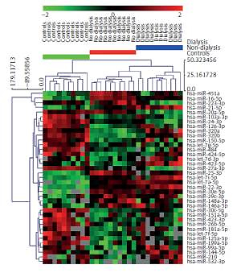

Serum microRNA profiles in patients with autosomal dominant polycystic kidney disease show systematic dysregulation partially reversible by hemodialysis
DOI: 10.5114/aoms.2019.86804
Arch Med Sci 2021;17(6):1730-1741
Notes:
Introduction
The impact of autosomal dominant polycystic kidney disease (ADPKD) on serum microRNAs (miRNA) is unknown.
Material and methods
For profiling experiment we recruited 30 patients from three equinumerous groups: controls, ADPKD and ADPKD on hemodialysis. From the last group extra samples were collected for in pre /post dialysis analysis. Additionally, 23 healthy volunteers were used for selected biomarker verification. Real-time PCR arrays were used for quantification of 752 miRNAs. Validation of selected miRNAs was performed in total RNA extracted from the serum and the exosomal fraction in pre /post dialysis samples.
Results
In total, 37 significant circulating miRNAs were found to differ between ADPKD patients and controls. In validation, 3 miRNAs with the highest fold change in comparison of dialyzed vs non-dialyzed patients (miR-532-3p, miR-320b, miR-144-5p) were not significantly altered by hemodialysis and from the top down-regulated ones, miR-27a-3p was significantly lower after dialysis in both total and exosomal fractions, miR-20a-5p was down-regulated in the exosomal fraction and miR-16-5p was unaltered by hemodialysis. MiR-16-5p was selected as the best circulating biomarker of ADPKD. Circulating representatives of the miR-17 family sharing the same seed region (miR-20a-5p, miR-93-5p and miR-106a-5p) showed significantly lower expression among dialyzed vs. non-dialyzed patients and their exosomal fraction dropped after hemodialysis.
Conclusions
The serum miRNAs among ADPKD patients differ substantially depending on the stage of CKD. The exosomal fraction of miRNA was more affected by dialysis than the total one. There was a common pattern of down-regulation for circulating miR-17 family members sharing the same seed region.

