Slide 1
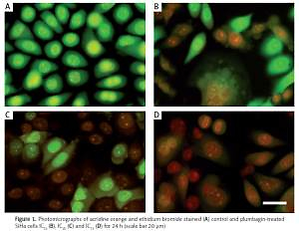

Plumbagin triggers redox-mediated autophagy through the LC3B protein in human papillomavirus-positive cervical cancer cells
DOI: 10.5114/aoms.2020.101072
Arch Med Sci 2022;18(1):171-182
Notes:
Introduction
In this study, we analyzed the effect of plumbagin (PL) on cultured SiHa cervical cancer cells using fluorescence microscopy and flow cytometry techniques to identify the mode of cell death and to elucidate whether cells die through apoptosis or non-apoptosis.
Material and methods
The cell death was analyzed using MTT assay. The cel­lular morphological changes were assessed using acridine orange/ethidium bromide dual staining. DNA damage and cell cycle progression were analyzed using a comet assay and flow cytometry respectively.
Results
Morphological and cytological features revealed that PL induced auto­phagic cell death in cancer cells. The results of a cell cycle analysis indicated that the proportion of cells in sub-G0 phase increased. Translocation of LC-3B protein from the cytoplasm to the autophagosome was found in 31% of PL-treated cells, suggesting that PL provoked autophagic cell death. In this study, it was observed that plumbagin treatment caused cleavage of DNA in SiHa cancer cells, and morphological analysis provided very strong evidence supporting the occurrence of autophagic cell death as a result of plumbagin treatment.
Conclusions
In addition, a Cytoscape-based protein-PL interaction network analysis provided very strong evidence in support of the specific mode of cell death in the context of autophagy, which has also been one of the desired endpoints in human papillomavirus-positive cervical cancer therapy and apoptotic cell death-resistant cancer treatment. Thus, this study is the first to test PL against the SiHa cervical cancer cell line, providing leads for further testing on non-apoptotic cell death for application in cervical cancer management.

