Slide 1
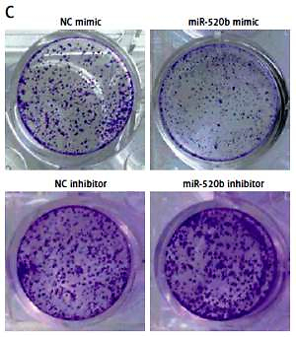

MiR-520b inhibits proliferation, migration and invasion in gallbladder carcinoma by targeting RAB22A
DOI: 10.5114/aoms.2019.89650
Arch Med Sci 2021;17(2):481-491
Notes:
Introduction
Previous studies have reported that miR-520b exhibited inhibitory effects on various human tumors, whereas the effects of miR-520b on gallbladder carcinoma (GBC) have remained unclear. To investigate the effects of miR-520b on GBC progression and reveal the underlying mechanisms, this study was performed.
Material and methods
MiR-520b and RAB22A mRNA levels were analyzed by quantitative real-time PCR (qPCR). RAB22A protein level was analyzed via Western blot and immunohistochemical (IHC) analysis. The proliferation, colony formation ability, migration and invasion of NOZ cells were measured via MTT, colony formation, wound healing and transwell invasion assay respectively.
Results
MiR-520b expression level was lower in human GBC tissues than that in neighboring normal tissues. MiR-520b mimic repressed NOZ cell proliferation, colony formation ability, migration and invasion, whereas miR-520b inhibitor exhibited opposite effects. Dual luciferase reporter assay confirmed that miR-520b could bind to the 3-untranslated regions of RAB22A mRNA. Moreover, RAB22A overexpression significantly abolished the anti-tumor effects of miR-520b in a NOZ cell model. Western blot, qPCR and IHC analysis proved that human GBC tissues showed a higher RAB22A expression level than neighboring normal tissues. Additionally, there was a negative association between miR-520b and RAB22A expression.
Conclusions
MiR-520b had suppressive effects on GBC via targeting RAB22A in vitro.

