Slide 1
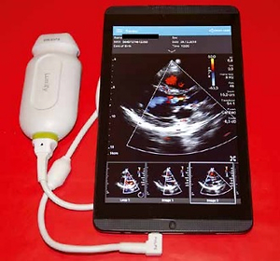

Feasibility and clinical utility of real-time tele-echocardiography using personal mobile device-based pocket echocardiograph
DOI: 10.5114/aoms.2019.83136
Arch Med Sci 2022;18(4):998-1003
Notes:
Introduction
Recently introduced microUSB ultrasound probe, which can be connected to personal mobile device constitutes a new class of diagnostic pocket size imaging devices (PSID).The aim of this study was to assess the feasibility and clinical utility of real-time tele-echocardiography with the use such device.
Material and methods
The study group comprised 30 patients (18 men and 12 women; mean age: 54 ±14 years; mean BMI: 27 ±6 kg/m2), admitted to various hospital departments (infectious diseases, internal medicine and cardiology). All patients underwent focused echocardiographic examination performed by an inexperienced operator using PSID and collaborating remotely in real-time with cardiologist by means of tele-consultation. Before commencing the examination, the operators underwent one hour training in use of the PSID.
Results
In most of patients PSID imaging provided sufficient diagnostic image quality. The dimensions of left ventricle, left atrium and the aorta obtained during the this examination showed good correlation with standard echocardiography (r = 0.89, r = 0.82, r = 0.92 respectively), but the correlation for TAPSE measurements was less pronounced (r = 0.52). The agreement in detection of pathologies (wall motion abnormalities, morphological and functional valvular abnormalities) between the tele-echocardiography and standard echocardiographic examination was good to very good ( ranged from 0.648 to 0.823).
Conclusions
Pocket size imaging devices allows an inexperienced operator to perform a focused echocardiographic examination under a remote supervision of an experienced cardiologist. The introduction of new technology in the form of PSID with tele-echocardiography feature can revolutionize access to this imaging technique.

