Slide 1
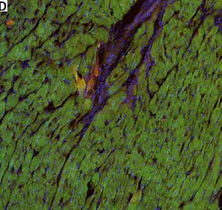

Increased oxytocinergic system activity in the cardiac muscle in spontaneously hypertensive SHR rats
DOI: 10.5114/aoms.2019.85446
Arch Med Sci 2022;18(4):1088-1094
Notes:
Introduction
The present study aimed to determine whether the presence of cardiac hypertrophy due to arterial hypertension is associated with a change in the activity of the oxytocinergic system in cardiomyocytes.
Material and methods
The experiments were performed on male, spontaneously hypertensive rats (SHR, n = 10) and normotensive Wistar-Kyoto rats (WKY, n = 12). Blood samples were collected from both SHR and WKY animals to asses plasma oxytocin (OT) concentration; the rats were sacrificed by decapitation. Samples of the left and right ventricles were harvested for the analysis of the OT and oxytocin receptor (OTR) protein by ELISA, and OT and OTR mRNA expression by RT-PCR. Immunohistopathological studies were performed to confirm the presence of OTR receptors in the cardiac muscle of the ventricles.
Results
Plasma OT concentration did not differ between SHR and WKY rats. In the SHR rats, the expression of OT mRNA and the OT protein level was higher in the left and the right ventricle, while OTR mRNA expression was significantly lower in both the left and the right ventricle. However, the level of OTR protein was higher only in the left ventricle of the SHR rats. The presence of OTR receptors was confirmed by immunohistochemical analysis in the muscle of the right and left ventricle.
Conclusions
The presence of arterial hypertension is associated with increased activity of the oxytocinergic system in the heart, especially in the area of the left ventricle. These findings support the important role of this system in the maintenance of cardiovascular homeostasis.

