Slide 1
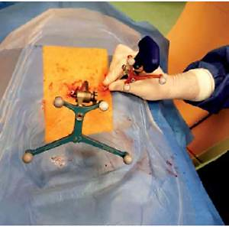

Use of O-arm with neuronavigation in percutaneous vertebroplasty reduces the surgeon’s exposure to intraoperative radiation
DOI: 10.5114/aoms.2019.84269
Arch Med Sci 2021;17(1):113-119
Notes:
Introduction
Percutaneous vertebroplasty is commonly used to treat spinal fractures. The authors compare radiation exposure as potential risk for the surgical team during vertebroplasty guided by O-arm combined with neuronavigation versus vertebroplasty guided by C-arm fluoroscopy.
Material and methods
The clinical material consisted of a group of 29 patients (44 vertebrae) with fractures of the thoracolumbar spine treated with percutaneous vertebroplasty guided by O-arm with neuronavigation. In this new method, the operating room staff leaves the operating room for the duration of the 3D scan of the appropriate spine section using the O-arm. In the next stage, the needle of the vertebroplasty system is introduced using only neuronavigation without the need for a radiological view. Finally, the cement injection was made under O-arm fluoroscopic control. The comparison group consisted of a group of 35 patients (40 vertebrae) treated with the classical method using C-arm fluoroscopy. The two methods were compared in terms of the average dose of emitted ionizing radiation through the device (O-arm vs. C-arm) to which surgeons are exposed during percutaneous vertebroplasty.
Results
As a result of vertebroplasty procedures guided by neuronavigation, a statistically significant difference between the values of mean dose of radiation emitted by O-arm and C-arm systems was noted. The O-arm emitted 912 cGy/cm2 vs. 1722 cGy/cm2 emitted by the C-arm during fluoroscopically assisted procedures and 601.28 cGy/cm2 vs. 1506.86 cGy/cm2 per vertebrae.
Conclusions
During vertebroplasty with the O-arm combined with neuronavigation the radiation dose is significantly lower as compared with the C-arm used for fluoroscopic guidance, minimizing the potential risk of radiation exposure to surgeons.

