Slide 1
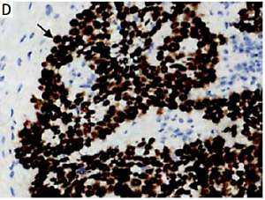

DEK overexpression is predictive of poor prognosis in esophageal squamous cell carcinoma
DOI: 10.5114/aoms.2019.84210
Arch Med Sci 2021;17(1):135-141
Notes:
Introduction
The DEK gene encodes a nuclear phosphoprotein which is involved in multiple cell metabolic processes, such as DNA damage repair, mRNA splicing, modifying chromatin structure and transcription regulation. DEK has been shown to be overexpressed in various solid human tumors and associated with patient prognosis. In this study, our aim was to investigate DEK protein expression and its relationship with clinicopathological parameters and prognosis in esophageal squamous cell carcinoma (ESCC).
Material and methods
Tissue samples were collected from 120 routinely diagnosed ESCC patients who underwent surgical resection at the Zhongshan Hospital, Xiamen University in the period from June 2011 to May 2013. The expression of DEK was determined by immunohistochemistry.
Results
DEK protein was ubiquitously distributed in the nucleus of ESCC cells, and its positive rate (71.7%) was significantly higher in cancer samples than those of para-carcinoma (21.4%) or normal esophageal (13.9%) tissues (p < 0.001). Similarly, significantly more cells overexpressing DEK were found in ESCC tissues (57.5%) in comparison with para-carcinoma samples (11.4%) and normal esophageal mucosa (0%, p < 0.001). The DEK overexpression rate was significantly different between patients with different tumor-node-metastasis (TNM) stages and differentiation degrees (p < 0.001). ESCC cases with elevated DEK amounts showed reduced disease-free and 5-year survival rates compared with those expressing low DEK amounts (p < 0.001). DEK overexpression was also confirmed to independently predict prognosis in ESCC (HR = 4.121, 95% CI: 1.803–9.42, p = 0.001).
Conclusions
DEK expression is positively correlated with reduced survival in ESCC patients. DEK has potential to be an independent biomarker in predicting prognosis of ESCC patients.

