Slide 1
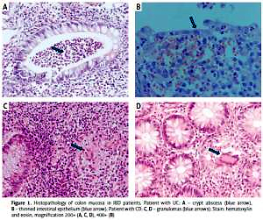

NGS study of glucocorticoids response genes in inflammatory bowel disease patients
DOI: 10.5114/aoms.2019.84470
Arch Med Sci 2021;17(2):417-433
Notes:
Introduction
Despite intensive research and a long history of glucocorticoids being applied in various clinical areas, they still generate a challenge for personalized medicine by causing resistance or dependence in nearly 50% of patients treated. The objective of the present study was to determine the genetic predictors of variable reactions in inflammatory bowel disease patients to glucocorticoid therapy. Therefore, based on the current knowledge on how glucocorticoids act, we have compiled a panel of 21 genes for variant analysis: NR3C1, NLRP1, IPO13, FKBP5, HSPA4, ABCB1, STIP1, HSP90AA1, IL-1A, IL-1B, IL-2, IL-4, CXCL8, IL-10, NFKBIA, JUN, MIF, TNF, MAPK14, CYP3A4, and CYP3A5.
Material and methods
These genes were analyzed using the amplicon next-generation sequencing method in a group of 139 diagnosed and clinically characterized inflammatory bowel disease patients with a confirmed glucocorticoid response.
Results
Analysis of all the targeted DNA sequences for the whole patient group indicated 121 different functional variants. After association analyses of 31 selected variants, the polymorphism c.1088A>G in the NR3C1 gene was linked with glucocorticoid resistance (p = 0.002), variant c.241+6A>G of the FKBP5 gene with glucocorticoid sensitivity (p = 0.040), and deletion c.306-7delT in the MAPK14 gene with an adverse therapeutic effect (dependency and resistance, p = 0.041) in ulcerative colitis patients. In Crohn’s disease, the change c.2685+49T>C of the ABCB1 gene related to glucocorticoid resistance (p = 0.034).
Conclusions
Among the 21 analyzed genes, four (NR3C1, FKBP5, MAPK14, and ABCB1) revealed a significant impact on the glucocorticoid treatment response, which could result in valuable pharmacogenetic biomarkers after being confirmed in other populations and in functional studies.

