Slide 1
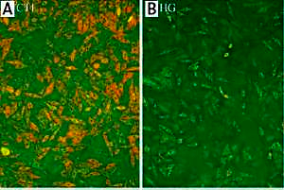

Naringin attenuates high glucose-induced injuries and inflammation by modulating the leptin-JAK2/STAT3 pathway in H9c2 cardiac cells
DOI: 10.5114/aoms.2019.84854
Arch Med Sci 2021;17(5):1145-1157
Notes:
Introduction
Our previous study showed that naringin (NRG) protects cardiomyocytes against high glucose (HG)-induced injuries by inhibiting p38 mitogen-activated protein kinase (MAPK). Leptin induces hypertrophy in rat cardiomyocytes via p38/MAPK activation. The present study aimed to test the hypothesis that leptin-Janus kinase 2 (JAK2)/signal transducers and activators of transcription 3 (STAT3), which are responsible for leptin’s functions, are involved in HG-induced injuries and cardioprotective effects of NRG in cardiomyocytes.
Material and methods
H9c2 cells were exposed to HG for 24 h to establish a cardiomyocyte injury model. Cells were pretreated with NRG and other drugs before exposure to HG. Protein expression was measured by western blot analysis. Cell viability was detected by Cell Counting Kit-8 assay. Apoptotic cells were assessed by Hoechst 33258 staining assay. Intracellular reactive oxygen species levels were determined by dichlorofluorescein diacetate staining. Mitochondrial membrane potential was evaluated using JC-1. An enzyme-linked immunosorbent assay was performed to determine the inflammatory cytokines.
Results
NRG significantly attenuated HG-induced increases in leptin and Ob-R expression. Pretreatment with either a leptin antagonist (LA) or NRG markedly ameliorated HG-induced elevation of phosphorylated (p)-JAK2 and p-STAT3, respectively. Pretreatment with NRG, LA, Ob-R antagonist, or AG490 clearly alleviated HG-induced injuries and inflammation.
Conclusions
This study provides new evidence of the NRG protective effects of H9c2 cells against HG-induced injuries possibly via modulation of the leptin-JAK2/STAT3 pathway.

