Slide 1
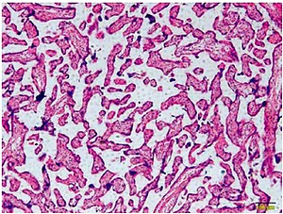

MiR-29b-3p affects growth and biological functions of human extravillous trophoblast cells by regulating bradykinin B2 receptor
DOI: 10.5114/aoms.2019.91512
Arch Med Sci 2022;18(2):499-522
Notes:
Introduction
This study investigated miR-29b-3p’s effects and mechanisms in preeclampsia development.
Material and methods
In this study, we analysed the pathology and expression of miR-29b-3p and B2R mRNA from normal and preeclampsia placenta tissues using hematoxylin and eosin staining and RT-qPCR assay. For cell experiments, we used transwell assay CCK-8, flow cytometry and wound healing assay to determine the effects and correlation of miR-29b-3p and B2R in HTR-8/SVneo cell proliferation, apoptosis, cell cycle, cell invasion and migration in a preeclampsia cell model. Moreover, the mechanisms were determined using Western blot or immunofluorescence in different groups.
Results
Clinical analysis revealed that miR-29b-3p gene expression dramatically increased with increasing degree of preeclampsia (p < 0.001 or p < 0.05, respectively). The HTR-8/SVneo cell biological activities of the model group were significantly depressed (p < 0.001). However, with miR-29b-3p inhibitor or B2R transfection, the HTR-8/SVneo cell biological activities significantly recovered (p < 0.001). Western blot assay showed that B2R, VEGF-A, CCND-1, MMP-2 and MMP-9 levels were suppressed in the model group, compared with those in the NC groups (p < 0.001, respectively). With miR-29b-3p inhibitor or B2R transfection, the protein expression levels of B2R, VEGF-A, CCND-1, MMP-2 and MMP-9 dramatically increased (p < 0.001, respectively).
Conclusions
The down-regulation of miR-29b-3p could improve HTR-8/SVneo cell biological activities in a preeclampsia cell model by targeting B2R.

