Slide 1
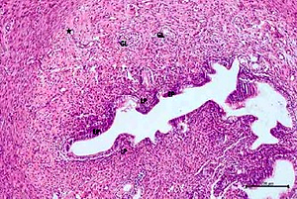

Can pycnogenol prevent cisplatin-induced damage in uterus and ovaries?
DOI: 10.5114/aoms.2019.90414
Arch Med Sci 2022;18(5):1364-1371
Notes:
Introduction
Cisplatin is an antineoplastic agent, which is thought to act on tissues with increased levels of reactive oxygen species and decreased levels of antioxidants. Pycnogenol is a potent antioxidant that is used in medical conditions caused by oxidative stress. The aim of our study is to demonstrate the effects of pycnogenol on cisplatin-induced uterine and ovarian damage in rats.
Material and methods
Wistar albino female rats were randomly divided into 3 groups before the experiment as follows: a 2.5 mg/kg cisplatin group (CG; n = 10), a 40 mg/kg pycnogenol + 2.5 mg/kg cisplatin group (PCG; n = 10), and a healthy control group (HG; n = 10). Then, the ovaries and uteri of the rats were examined to determine malondialdehyde (MDA), total glutathione (tGSH) and superoxide dismutase (SOD) biochemical levels and the histopathological findings.
Results
Our study demonstrated that, in uterine and ovarian tissues of rats administered with cisplatin, there was a decrease in the levels of tGSH and SOD, while MDA was increased; however, it was observed that these ratios were reversed in the PCG group (p < 0.05). The number of follicles in the ovarian tissues was examined in all 3 groups. When the CG group was compared with the other two groups, the number of primordial, developing and atretic follicles was low, but there was no difference in the corpus luteum count.
Conclusions
Pycnogenol pretreatment alleviates cisplatin-induced uterine and ovarian injury in rats because of its antioxidative effect.

