Slide 1
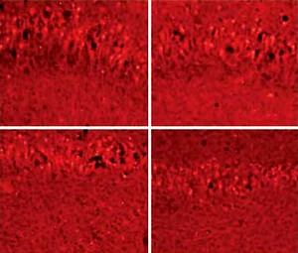

The effects of hepatic ischemia/reperfusion injury on postoperative cognitive function in aged rats
DOI: 10.5114/aoms.2019.90335
Arch Med Sci 2022;18(5):1357-1363
Notes:
Introduction
Hepatic ischemia/reperfusion injury (I/R) is a significant source of morbidity and mortality after liver surgery. The aim of this study was to investigate the effect of hepatic I/R injury on the hippocampus in rats with postoperative cognitive dysfunction (POCD).
Material and methods
Adult male Sprague-Dawley rats (n = 160, age: 20–25 months, weight: 300–350 g) received I/R surgery with ischemia for 20 minutes, 30 minutes, and 40 minutes in different groups. Behavior tests of the Morris water maze (MWM) test and the passive avoidance test were applied. Population spike (PS) of pyramidal cells, nuclear factor kappa-B (NF-κB) and protein kinase γ (PKCγ) in the hippocampus were observed.
Results
Within 10 days after surgery, in aged rats with varying impaired cognitive function, spike size and spike latency period were reduced, level of PKCγ was decreased and an increased level of NF-κB was observed in the I/R group, especially in the I/R group with ischemia for 40 minutes. The parameters showed no significant difference in rats in the I/R group compared with the sham group at the 18th day after surgery.
Conclusions
Hepatic I/R injury has a negative impact on the postoperative cognitive function in aged rats, leading to hippocampus changes with PS abnormity and level changes of NF-κB, PKCγ. However, this cognitive deficit improved over time.

