Slide 1
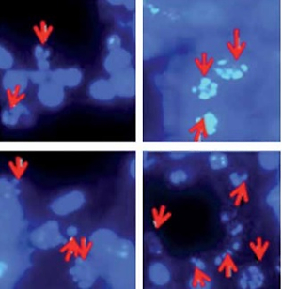

Bergamottin exerts anticancer effects on human colon cancer cells via induction of apoptosis, G2/M cell cycle arrest and deactivation of the Ras/Raf/ERK signalling pathway
DOI: 10.5114/aoms.2019.86226
Arch Med Sci 2022;18(6):1572-1581
Notes:
Introduction
Accumulating evidence has shown the potential of bergamottin as an anticancer agent. The present study was undertaken to evaluate the anticancer affects of bergamottin (µM) against colon cancer cells.
Material and methods
Antiproliferative effects were evaluated by WST-1 cell viability assay. Apoptotic effects were studied by DAPI and Annexin V/PI staining. Cell cycle analysis was carried out by flow cytometry. Transwell assay was used to study the effects on cell invasion. Protein expression was estimated by the western blot method.
Results
The results showed that bergamottin suppresses the proliferation of all the human colon cancer cell lines. Nonetheless, the growth inhibitory effects of bergamottin on the HT-29 and RKO cells were more significant (IC50, 12.5 µM). The anticancer effects of bergamottin on the HT-29 and RKO cells were mainly due to apoptosis. Bergamottin could considerably increase the expression of Bax and reduce the expression Bcl-2. The cleavage of caspase-3, 8 and 9 was also enhanced upon bergamottin treatment of the colon cancer cells. Flow cytometric analysis showed that bergamottin also induced G2/M cell cycle arrest of the HT-29 and RKO cells. Additionally, bergamottin could also suppress the invasion of HT-29 and RKO cells. The Raf/MEK/ERK pathway is regarded as one of the essential pathways involved in the development and progression of cancers. Herein, it was observed that bergamottin could concentration dependently block this pathway in colon cancer cells. In vivo study revealed that bergamottin could also suppress the growth of tumours in xenografted mice models.
Conclusions
Taken together, bergamottin suppresses the proliferation of colon cancer cells and may be utilised in the development of chemotherapy for colon cancer.

