Slide 1
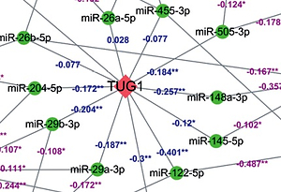

The identification and preliminary study of lncRNA TUG1 and its related genes in hepatocellular carcinoma
DOI: 10.5114/aoms.2019.89707
Arch Med Sci 2022;18(6):1582-1595
Notes:
Introduction
Hepatocellular carcinoma (HCC) is a common malignant tumour of the digestive system, which is a threat to public health. The purpose of this study was to investigate the featured genes and pathways of HCC from a bioinformatics database, and verify their correlation with diagnosis and prognosis of HCC.
Material and methods
We downloaded the gene expression profile on HCC from the Gene Expression Omnibus (GEO), and software R was used to identify differentially expressed lncRNA (DEL). The target genes of the lncRNA were further predicted by using a cluster database and molecular interaction database. Subsequently, a combined interaction network of target genes was constructed using the Cytoscape platform with preliminary verification at the level of different databases, cell lines, and tissues. Finally, we explored the effectiveness of TUG1 and its target genes on the diagnosis and prognosis of HCC by univariate Cox analysis and survival analysis.
Results
A total of four DELs were identified and the most remarkably up-regulated lncRNA was TUG1, which included 12 high-confidence target genes. Moreover, we found that the expression changes of TUG1 and its target genes in different databases, cell lines, and liver cancer tissues were consistent with the prediction. The high expression of TUG1 and its target genes could significantly predict the shorter survival time of HCC patients, among which NCAPG, MCM6, PIGC, PEA15, and RACGAP1 have significant diagnostic value for HCC (AUC > 0.9).
Conclusions
This study provides a starting point for the screening of therapeutically relevant targets in HCC. Further experiment should be conducted to verify our findings.

