Slide 1
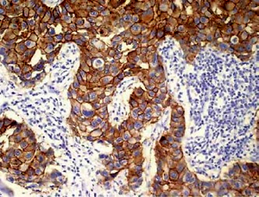

Medullary breast cancer is a predominantly triple-negative breast cancer – histopathological analysis and comparison with invasive ductal breast cancer
DOI: 10.5114/aoms.2019.86763
Arch Med Sci 2022;18(2):432-439
Notes:
Introduction
Medullary breast cancer (MdBC) is an uncommon type of breast cancer representing 1–7% of all cases. It is characterized by the occurrence of many histopathological features associated with a high grade of malignancy.
Material and methods
Twelve MdBCs chosen from a group of 1,122 women suffering from invasive breast cancer were analyzed. Histopathological examination and analysis of a basic molecular profile, i.e. estrogen (ER), progesterone (PR) and HER2 receptor expression, and their comparison with invasive ductal breast cancer (IDC), were performed.
Results
MdBC accounted for 1.07% of all analyzed invasive breast cancer patients. All patients were female, with an average age of 58.54 years. The MdBC group exhibited a larger median tumor diameter (2.05 vs. 1.89 cm), although ≥ T2 tumors comprised 42% vs. 51% for IDCs. Women without regional lymph node involvement (pN0) (83%) formed the largest group. There was a statistically significant difference in the presence of nodal involvement between the studied groups (p < 0.001). Based on the histological grade of malignancy, the majority of MdBC comprised grade II tumors (G2) (93%). In general, MdBC showed statistically higher histologic grade (G1-G3) than IDC (p = 0.003). The 5-year overall survival rate of MdBC patients was 91%. Most MdBCs (92%) were triple-negative, whereas the remaining 8% were HER2 positive.
Conclusions
MdBC presented at a younger age than IDC, had a higher histological grade, larger median size and less frequent regional lymph node involvement. Most MdBCs were triple-negative, whereas IDCs were predominantly luminal. Despite numerous aggressive pathological features of MdBC, its clinical outcome and overall prognosis are favorable.

