Slide 1
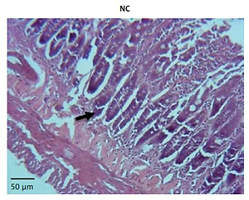

miRNA-21 plays an important role in necrotizing enterocolitis
DOI: 10.5114/aoms.2019.88013
Arch Med Sci 2022;18(2):406-412
Notes:
Introduction
To investigate the role and mechanism of miRNA-21 in necrotizing enterocolitis (NEC).
Material and methods
Collecting 30 pairs of newborn and NEC children and measuring the miRNA-21 expression in the serum of 30 pairs. Thirty neonatal Wistar rats were randomized to 3 groups: NC, Model and miR-NA groups. The rats of model and miRNA groups were based on NEC model groups, after the fab-ricated NEC model of neonatal rats. The Model group was treated with normal saline and the miRNA group was injected with miRNA-21 from the abdomen. On the 4th day, all the rats were ex-ecuted. The intestinal tissue located at the boundary of the ileum and cecum was sampled for his-tology and cell apoptosis. The relative protein (PTEN, PI3K, AKT and GSK-3β) expression levels of difference groups were evaluated by WB assay.
Results
In the clinical data, the miRNA-21 gene expression of NEC children was significantly up-regulation compared with that of normal newborns (p < 0.05). In the rat experiments, compared with the NC group, the pathology and cell apoptosis of the Model group showed significant deterioration (p < 0.05) and relative protein (PTEN, p-PI3K, p-AKT and p-GSK-3β) expression levels were signifi-cantly different (p < 0.05, respectively). However, the pathology and cell apoptosis of colonic tissue were significantly improved (p < 0.05), the PTEN and p-GSK-3β protein expression levels were sig-nificantly suppressed (p < 0.05) and p-PI3K and p-AKT protein expression levels were significantly increased (p < 0.05, respectively) with miRNA-21 over-expression compared with the Model group.
Conclusions
miRNA might be a biological marker and therapeutic target in NEC diagnosis and treatment.

