Slide 1
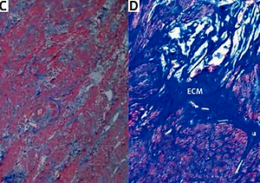

Identification of PDGFRα+ cells in uterine fibroids – link between angiogenesis and uterine telocytes
DOI: 10.5114/aoms.2019.86795
Arch Med Sci 2022;18(5):1329-1337
Notes:
Introduction
Telocytes (TCs), also called interstitial Cajal-like cells (ICLC), CD34+ cells or PDGFR+ cells (platelet-derived growth factor receptor  positive cells), a new type of cell of mesenchymal origin, were described over one decade ago. The unique nature of these cells still deserves attention from the scientific community. Telocytes make homo- and heterocellular contact with myocytes, immunocytes and nerves, have their own immunohistochemical and secretome profiles and thus might regulate local regenerative processes including angiogenesis and fibrosis. The aim of our study was to observe the missing link between angiogenesis and telocytes in leiomyoma, the most common benign tumors affecting women of reproductive age.
Material and methods
We observed uterine tissue samples from leiomyoma, adjacent myometrium and unchanged tissue from patients with leiomyoma and control subjects using routine histology, histochemistry, immunofluorescence (CD117, CD31, CD34, PDGFRα, tryptase, sFlt-1) and image analysis methods.
Results
The decline of the telocyte density in the foci of fibroids correlated with poor vascularization inside the leiomyoma. Moreover, the expression of sFlt-1 (anti-angiogenic-related factor) significantly increased inside a fibroid. In leiomyoma the decrease of telocyte and blood micro-vessel density was accompanied by prevalence of collagen deposits, unlike the unchanged myometrium.
Conclusions
Our results demonstrate TCs in human uterine fibroids and highlight their possible involvement in the pathogenesis of myometrial pathology in the context of angiogenesis.

