Slide 1
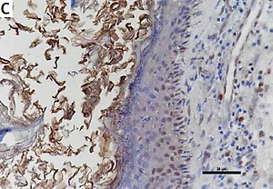

Low expression of microRNA-125b enhances the expression of STAT3 and contributes to cholesteatoma growth
DOI: 10.5114/aoms.2019.89704
Arch Med Sci 2022;18(6):1596-1606
Notes:
Introduction
MicroRNA-125b has been found to be down-regulated in many types of malignant tumours and diseases with excessive proliferation of keratinocytes, such as cutaneous squamous cell carcinoma and psoriasis. Cholesteatoma, which is mainly composed of keratinocytes, also has characteristics of abnormal proliferation similar to a malignant tumour. However, the expression and regulatory mechanisms of miR-125b and its downstream genes in cholesteatoma have not been clarified.
Material and methods
Real time fluorescence quantitative PCR was applied to detect the expression of miR-125b in the cholesteatoma and corresponding retroauricular skin. Immunohistochemical staining and western blot were used to detect signal transducers and activators of transcription 3 (STAT3) and the downstream gene cyclin D1, survivin, and vascular endothelial growth factor (VEGF) in the cholesteatoma and corresponding retroauricular skin. The targeted regulatory relationship between miR-125b and STAT3 was confirmed by dual luciferase reporter assay. Proliferation and apoptosis of transfected HaCaT cells were detected by MTS, cell cycle, and apoptosis assays.
Results
We observed down-regulation of miR-125b and up-regulation of STAT3, cyclin D1, survivin, and VEGF in cholesteatoma tissues. STAT3 was a direct target gene of miR-125b. Inhibition of miR-125b enhanced STAT3 and its downstream genes expression, promoted HaCaT cell proliferation, and inhibited apoptosis.
Conclusions
The results of this study demonstrate that miR-125b can influence the growth of cholesteatoma by targeting STAT3 and its downstream genes, including cyclin D1, survivin, and VEGF, thus providing an opportunity to establish new medical therapy strategies and facilitating further study of the pathogenesis of cholesteatoma.

