Slide 1
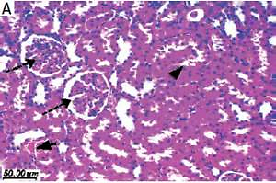

Upregulation of antioxidant nuclear factor erythroid 2-related factor 2 and its dependent genes associated with enhancing renal ischemic preconditioning renoprotection using levosimendan and cilostazol in an ischemia/reperfusion rat model
DOI: 10.5114/aoms/111373
Arch Med Sci 2021;17(6):1783-1796
Notes:
Introduction
Ischemic preconditioning (Ipre) provides protection against renal ischemia-reperfusion (I/R) injury with its associated remote organ damage. This study examined the enhancing protective effect of Ipre with levosimendan or cilostazol in I/R-induced kidney and lung injury in a rat model.
Material and methods
Rats were divided into: sham-operated, I/R control, Ipre control, I/R + cilostazol or levosimendan and Ipre + cilostazol or levosimendan. Drugs were given 30 min before left renal I/R or 4 cycles of Ipre just before renal ischemia.
Results
The Ipre combined with the implemented drugs enhanced physio­logical antioxidant defense genes including renal nuclear factor erythroid 2-related factor 2 (Nrf2) and its dependent genes heme oxygenase-1 (HO-1) and NADPH-quinone oxidoreductase-1 (NQO-1) and improved malondialdehyde and superoxide dismutase renal tissue levels. The combined effect improved I/R consequences for blood urea, creatinine, and creatinine clearance and improved blood oxygenation and metabolic acidosis. Moreover, the combination improved the renal soluble intercellular adhesion molecule (ICAM), tumor necrosis factor  (TNF-) and interlukin-6 (IL-6) with histopathological improvement of tubular necrosis with a decrease in the apoptotic marker caspase-3 and an increase in the anti-apoptotic Bcl-2 expression.
Conclusions
Cilostazol or levosimendan potentiates the renoprotective effect of Ipre against renal I/R injury, associated with upregulation of antioxidant genes Nrf2, HO-1, and NOQ-1 expression.

