Slide 1
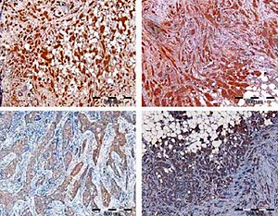

Expression of pendrin and NIS iodide transporters in human breast tumor and peri-tumoral tissue
DOI: 10.5114/aoms.2019.89980
Arch Med Sci 2022;18(4):1041-1050
Notes:
Introduction
Thyroid iodide transporters, Na+/I– symporter (NIS) and pendrin (PDS), are responsible for supplying this vital micronutrient for thyroid hormone synthesis by thyroid peroxidase (TPO). Both proteins were shown to be expressed, apart from the thyroid, also in other human tissues, including lactating mammary gland. NIS expression in human breast cancers has been widely studied. On the other hand, until now PDS mRNA levels in breast tumor tissue have been estimated only in high throughput analyses. Previously, we have observed that TPO is expressed in normal and cancerous human breast tissues and shows enzymatic activity. However, biochemical activity of TPO in human breast cancer cells requires iodide transport by NIS and PDS. Therefore, to extend our previous study on TPO expression and function in human breast tumors we performed analysis of NIS and PDS levels in the same group of patients.
Material and methods
The study involved detection of NIS and PDS protein levels by immunohistochemistry and Western blotting, as well as mRNA levels by real-time quantitative polymerase chain reaction.
Results
Here we provide direct evidence that NIS and PDS are expressed in human breast cancer tissue, with NIS levels being increased and PDS levels decreased in tumor tissue. Interestingly, PDS mRNA levels in breast cancer tissue seem to be influenced by the estrogen receptor status and age of the patients, while NIS mRNA levels were dependent on histological type of the tumor.
Conclusions
This study provides valuable information important for consideration in diagnostic or therapeutic application of radioiodine in breast cancer management.

