Slide 1
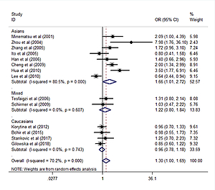

Association of the MMP-3, MMP-9 and MMP-12 gene polymorphisms with COPD risk: a meta-analysis
DOI: 10.5114/aoms/114117
Arch Med Sci 2024;20(1):196-206
Notes:
Introduction
Given the evidence that the matrix metalloproteinases (MMPs) play an important role in the pathogenesis of chronic obstructive pulmonary disease (COPD), a number of case-control studies have attempted to assess the relationship between genetic polymorphisms in MMP genes and COPD risk. However, reliable measures of these results are lacking.
Material and methods
We assessed the published evidence for association of the MMP-3, MMP-9 and MMP-12 polymorphisms with COPD risk using meta-analytic techniques. The odds ratio (OR) and 95% confidence interval (CI) were calculated for each study using fixed or random effect models.
Results
A total of 23 case-control studies were included in the meta-analysis. No significant association was observed between the MMP-9 rs3918242 polymorphism and COPD risk in the overall populations under the dominant (T/T + C/T vs. C/C: OR = 1.30, 95% CI: 1.00–1.69, p = 0.054) and allele contrast (T allele vs. C allele: OR = 1.22, 95% CI: 0.97–1.53, p = 0.088) models. However, in sub-group analysis the polymorphism rs3918242 was significant in Asians under the dominant model (T/T + C/T vs. C/C: OR = 1.66, 95% CI: 1.02–2.72, p = 0.043). The results for MMP-12 rs2276109 showed an association with COPD only in mixed populations (G/G + A/G vs. A/A: OR = 1.57, 95% CI: 1.10–2.24, p = 0.013; G allele vs. A allele: OR = 1.52, 95% CI: 1.09–2.14, p = 0.015). We did not find any significant association of the MMP-12 rs652438 and MMP-3 rs35068180 polymorphisms with COPD.
Conclusions
The findings of this meta-analysis suggest that there is a risk of COPD associated with the MMP-9 rs3918242 and MMP-12 rs2276109 polymorphisms in certain ethnic groups.

