Slide 1
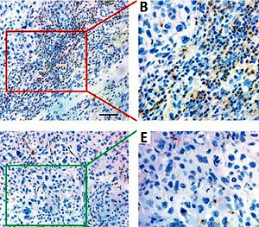

Prognostic role of CD11b<sup>+</sup> myeloid-derived suppressor cells in oral squamous cell carcinoma
DOI: 10.5114/aoms/116683
Arch Med Sci 2023;19(1):171-179
Notes:
Introduction
Myeloid-derived suppressor cells (MDSCs) are critically involved in cancer immune suppression and MDSC density has been recognized as a robust prognostic biomarker. Here, we sought to characterize the densities and locations of CD11b<sup>+</sup> MDSCs in primary oral squamous cell carcinoma (OSCC) and determine their prognostic significance.
Material and methods
A total of 144 eligible OSCC samples from a tertiary referral oral cancer center were retrospectively collected. Intensities of CD11b<sup>+</sup> MDSCs at the tumor center (CT) and invasive margin (IM) in OSCC samples were detected by immunohistochemistry and automatically quantified using Image J software. The optimal cutoff values for CD11b CT and CD11b IM were determined by X-tile based on overall survival. The associations between CD11b+ MDSCs and clinicopathological parameters were assessed by the x<sup>2</sup> test. The prognostic value of CD11b<sup>+</sup> MDSCs was evaluated by Kaplan-Meier plots, Cox regression analyses and receiver operating characteristics curves.
Results
High density of CD11b<sup>+</sup> MDSCs at CT or IM was significantly associated with inferior overall and disease-free survival (Kaplan-Meir, p < 0.05, log-rank test). CD11b CT and CD11b IM were identified as independent prognostic predictors for patient survival. The prediction accuracy and specificity of CD11b CT and CD11b IM were superior to other prognostic parameters.
Conclusions
Our data indicated that increased densities of CD11b<sup>+</sup> MDSCs in CT and IM regions were significantly associated with poor prognoses, which might be novel prognostic factors for OSCC.

