Slide 1
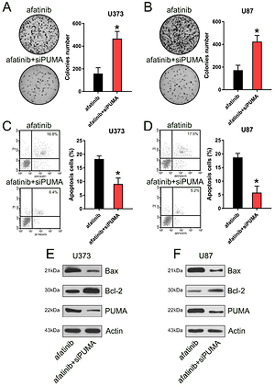

PUMA mediated afatinib-induced apoptosis in glioma cells
DOI: 10.5114/aoms/119970
Arch Med Sci 2025;21(4):1458-1470
Notes:
Introduction
Afatinib exhibits a tumor-inhibiting effect in different cancers by inducing apoptosis; however, its pro-apoptosis role in glioma cells is still not fully understood.
Material and methods
In the current study, two glioma cell lines (U373-MG and U87-MG) were treated with afatinib to measure their tolerance for afatinib-triggered cell death and apoptosis.
Results
We found that afatinib treatment repressed both growth and proliferation and induced apoptosis in glioma cells. Moreover, it increased the expression of pro-apoptotic p53-upregulated modulator of apoptosis (PUMA). The influence of PUMA on afatinib-triggered apoptosis was assessed by PUMA overexpression and knockdown in glioma cell lines. PUMA overexpression resulted in increased sensitivity of glioma cell lines toward afatinib, whereas its knockdown abated the effect of afatinib on apoptosis. Similarly, the in vivo potency of afatinib on U373-MG xenograft tumors in wild type (WT) and PUMA knockdown nude mice was measured. Afatinib treatment reduced the weight and volume of WT xenograft tumors but did not have the same effect on PUMA knockdown xenograft tumors. Afatinib also induced significant cell death and apoptosis in WT xenograft tumors but not in PUMA knockdown xenograft tumors.
Conclusions
Afatinib induces apoptosis in glioma cells by mediating PUMA expression. This study warrants further investigation into the mechanism of afatinib in glioblastoma treatment.

