Slide 1
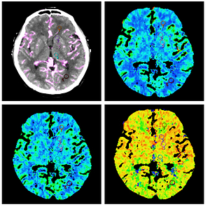

Effectiveness of low-tube current for reducing radiation dose in cerebral CT perfusion
DOI: 10.5114/aoms/122209
Arch Med Sci 2026;22(1):104-113
Notes:
Introduction
This study aims to investigate the reduction of radiation dose in cerebral computed tomography (CT) perfusion by lower low-tube current.
Material and methods
Two hundred patients, who underwent cerebral non-contrast CT and CT perfusion, were randomized to four groups according to tube current and contrast media (CM) concentration: group A (60 mAs, 320 mg I/ml), group B (60 mAs, 370 mg I/ml), group C (100 mAs, 320 mg I/ml), and group D (100 mAs, 370 mg I/ml). Among these four groups, the CT dose index (CTDIvol), dose length product (DLP) and effective dose (ED) were calculated. The quantitative image comparison included maximum enhancement, noise, signal-to-noise ratio (SNR), cerebral blood volume (CBV), cerebral blood flow (CBF), and mean transit time (MTT) from five regions of interests (ROIs).
Results
Ranging from 100 mAs to 60 mAs, groups A and B achieved 40% lower CTDIvol, DLP and ED, compared with groups C and D. Both the maximum enhancement and noise of all ROIs were higher in groups A and B than in groups C and D (p < 0.05). The CBV values were higher in groups B and D than in groups A and C (p < 0.05). The image quality (IQ) of each group of perfusion maps met the requirements for imaging diagnosis.
Conclusions
The reduction in tube current from 100 mAs to 60 mAs for cerebral CT perfusion led to a 40% reduction in radiation dose without sacrificing image quality.

