Slide 1
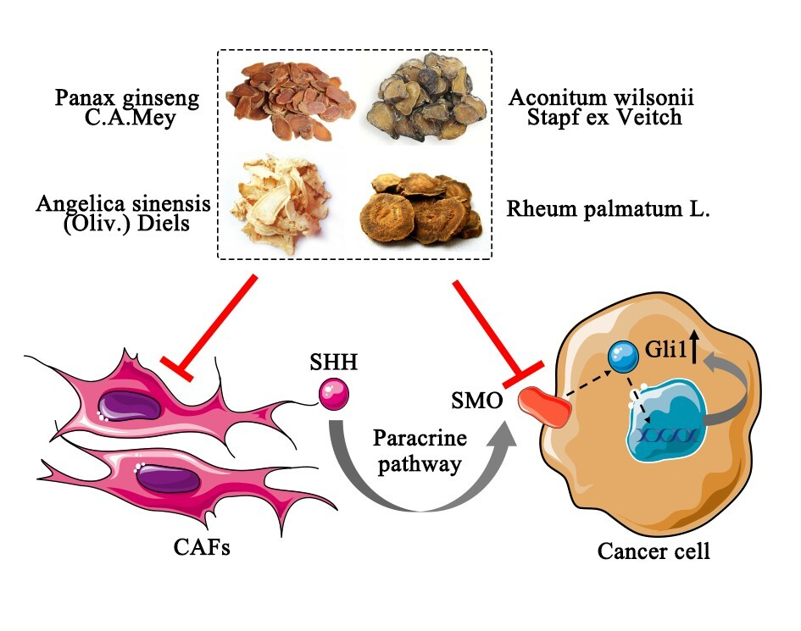

The anti-lung cancer effect of ethyl acetate extract from Wenxia Formula in vivo via the Hedgehog-Gli1 signaling pathway mediated by cancer associated fibroblasts
DOI: 10.5114/aoms.2020.100106
Arch Med Sci 2026;22(2):1034-1044
Notes:
Introduction
Previous research had shown that the ethyl acetate extract from Wenxia Formula (WFEA extract) had significant effects in inhibiting tumor and cancer associated fibroblasts (CAFs). However, the anti-cancer mechanism of the WFEA extract was still unclear. In this study, we aimed to illuminate the possible anti-cancer mechanisms of the WFEA extract.
Material and methods
Ultra-performance liquid chromatography quadrupole time-of-flight mass spectrometry (UPLC/Q-TOF-MS) was applied to analyze and identify the constituents of WFEA extract. The lung cancer xenograft model was conducted to explore the antitumor activity of WFEA extract by measuring tumor volume and weight, HE staining, immunohistochemistry, and immunofluorescence assay. Western blot and qRT-PCR were used to measure the expressions of related proteins and genes in the Hedgehog-Gli1 (Hh-Gli1) signaling pathway.
Results
A total of 15 chemical constituents were identified in the WFEA extract. The xenograft model showed that WFEA extract could inhibit tumor growth and had no significant effect on body weight of mice. In addition, WFEA extract reduced the expression of a-SMA, FAP and N-cadherin in the CAF mediated lung cancer xenograft model and increased the expression of E-cadherin. Western blot and qRT-PCR showed that WFEA extract reduced the expression of related proteins and genes (Smo, Gli1 and Ptch1) in the Hh-Gli1 signaling pathway.
Conclusions
WFEA extract had a certain inhibitory effect on lung cancer, and its mechanism may be related to the CAF mediated Hh-Gli1 signaling pathway.

