Slide 1
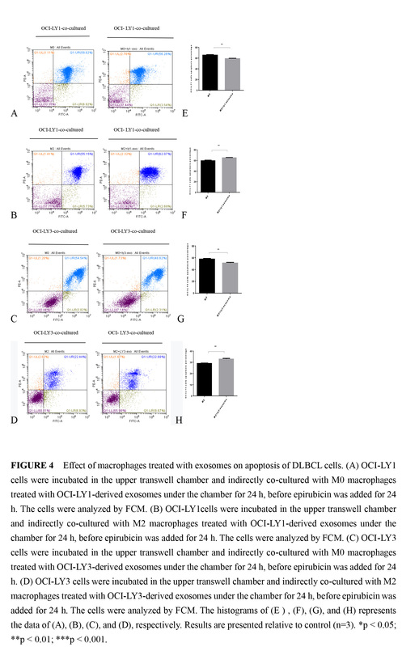

The impact of diffuse large B-cell lymphoma-derived exosomes on macrophage polarisation and cytokine release
DOI: 10.5114/aoms.2020.97355
Arch Med Sci 2026;22(2):1084-1096
Notes:
Introduction
The pro-tumoural role of M2 macrophages has been described in various cancers and is associated with poor clinical outcomes. Exosomes derived from cancers can shuttle information among tumour cells, immune cells, and the microenvironment, leading to microenvironment remodelling. The mechanism involved in exosomes influencing macrophages polarisation is still unclear.
Material and methods
We established a macrophage model derived from THP-1 monocytes. To mimic the in vivo microenvironment, we generated an indirect co-culture system of macrophages with diffuse large B-cell lymphoma (DLBCL) cell lines, OCI-LY1 and OCI-LY3 cells. In addition, pre-treated macrophages with exosomes derived from OCI-LY1/3 lymphoma cells were used in our study. The changes in macrophage polarisation stage, surface receptor expression, and cytokine expression at the mRNA level were analysed. Moreover, the effect of macrophages on drug-induced lymphoma cell apoptosis in the indirect co-culture system was assessed. Furthermore, protein analysis of NF-kB and p-p65 in macrophages exposed to exosomes was performed by western blot.
Results
DLBCL-derived exosomes had different effects on macrophages at different differentiation stages; these macrophages had different effects on drug-induced apoptosis of lymphoma cells in indirect co-culture. Moreover, NF-kB signalling molecules were involved in this process.
Conclusions
The results indicate that DLBCL-derived exosomes can lead to more M2 phenotypes, promote tumour growth, and play a substantial role in tumour progression, invasion, and drug-resistance.

