Slide 1
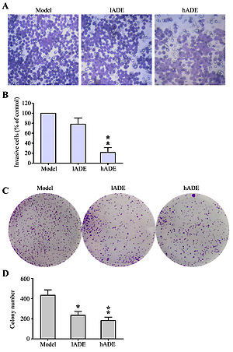

The effect of Angelica dahurica extract on breast carcinogenesis in mouse
DOI: 10.5114/aoms.2020.101281
Arch Med Sci 2026;22(3)
Notes:
Introduction
Angelica dahurica extract (ADE) has been demonstrated to possess functions of immune response modulation, breast injury and fibrosis amelioration, breast regeneration regulation, and suppression of breast cancer.
Material and methods
To explore the effect of the ADE on breast cancer generation and epithelial-mesenchymal transition (EMT) in vivo, a breast cancer mouse model was established. Chinese traditional medicine ADE was administered to mice bearing breast cancer, which were randomly divided into a negative group, ADE group (two doses), and model group. The breast tissue of the mouse model was fixed and H&E staining was performed for subsequent histological observation. Immunofluorescence assay and immunohistochemical staining were performed to examine the breast cancer related proteins, SNCG and BCRP in breast tissue; Western blotting and quantitative real-time polymerase chain reaction (PCR) were performed to detect proteins and gene expression of epithelial-mesenchymal transition (EMT)-related markers, E-cadherin, N-cadherin, vimentin, transforming growth factor  (TGF-), and SNAIL, as well as signals in the MAPK and JAK/STAT signaling pathways.
Results
Pathological manifestation of breast tissues in ADE-treated mouse was clearly reduced in both visual inspection and H&E staining. Breast cancer specific SNCG and BCRP expression significantly decreased after ADE administration. Furthermore, increased E-cadherin and decreased N-cadherin, vimentin, SNAIL and TGF- expression might be associated with the anti-EMT property of ADE. Both MAPK and JAK/STAT signaling pathways were observed to be inactivated after ADE treatment.
Conclusions
Collectively, the evidence showed that ADE restrained breast cancer development in vivo through blocking the EMT process, probably by down-regulation of MAPK and JAK/STAT signaling pathways.

