Slide 1
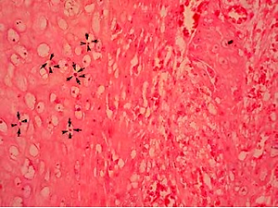

Warty carcinoma of the uterine cervix: a virus-induced disease?
DOI: 10.5114/aoms.2020.97997
Arch Med Sci 2022;18(5):1248-1252
Notes:
Introduction
Warty carcinoma (WC) of the uterine cervix is a rare subtype of squamous-cell carcinoma (SCC), and its frequency, clinical behaviour, and aetiology are obscure. It originates from condylomas, and a viral carcinogenesis seems logical.
Material and methods
Retrospective analysis was performed of all cervical carcinomas (CC), diagnosed at a single institution for a 10-year period. Analysed patients had stage I carcinoma. Patients with WC were identified, and their tumour samples were tested for high-risk HPV (hr-HPV) and EBV, using PCR and ISH. Clinical characteristics and WC rates across all stage I CC patients were assessed. All patients had minimum 3-year follow-up, and overall survival (OS) and 5-year survival rates were calculated.
Results
WC comprised 2.2% of all stage I CC (n = 630). The mean age of the patients was 48 years (range: 29–72). The primary tumour size was 2 cm in 4 (28.6%) patients, 2–4 cm in 2 (14.3%) patients, and 4 cm in 8 (57.1%) patients. Lymph node metastasis was found in 1 (7.1%) patient. EBV or hr-HPV were detected in 2 (18.2%) patients using ISH, with no coinfection reported. Hr-HPV was detected in 2 (18.2%) patients; EBV in 4 (36.4%) cases, and in 2 of them (18.2%) there was a co-infection. Thirteen patients had a follow-up of ≥ 5 years and their 5-year OS was 100%.
Conclusions
WC is a rare subtype of SCC with good prognosis, regardless of viral status. In contrast to SCC, its aetiology is not related to hr-HPV. The role of EBV remains unclear and cannot currently be denied.

