Slide 1
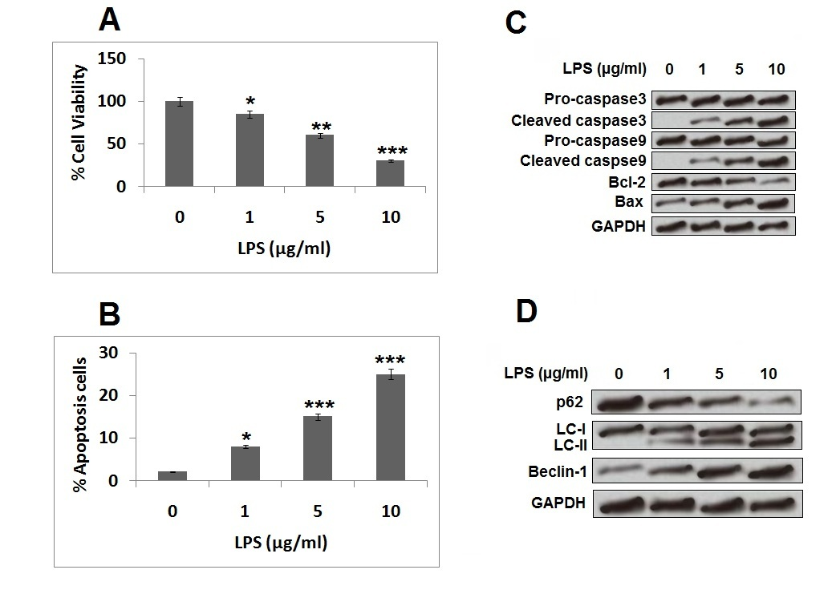

miR-93-5p attenuates apoptosis and autophagy by regulating SRY-box2 in spinal cord-injured rats <i>in vivo</i> and PC12 cells <i>in vitro</i>
DOI: 10.5114/aoms.2020.98142
Arch Med Sci 2026;22(2):1119-1129
Notes:
Introduction
In the current work we studied the involvement of miR-93-5p in spinal cord injury (SCI) by involving SCI rats and LPS-mediated injuries in PC12 cells.
Material and methods
The PC12 cells were exposed to LPS in order to induce cell injury that mimicked the in vitro model of spinal cord injury. The in vivo model was created by submitting rats to contusion injury. The cell apoptosis and viability were evaluated by flow cytometry and cell counting kit (CCK-8). The expression of various apoptosis and autophagy-related proteins was done by western blot assay.
Results
The treatment of LPS caused cell injuries in PC12 cells. The levels of miR-93-5p were suppressed in LPS-injured cells. Over-expression of miR-93-5p decreased autophagy and apoptosis and increased cell viability in LPS injured cells via up-regulation of SRY-box2. Up-regulation of SRY-box2 ameliorated LPS-mediated cell injury whereas suppression of SRY-box2 accelerated the LPS-mediated cell injury. Also, upregulation of miR-93-5p blocked the JAK/STAT and MAPK/ERK pathways via up-regulating the expression of SRY-box2. Treatment in SCI rats with miR-93-5p agomir inhibited cell apoptosis and autophagy.
Conclusions
The results of the study confirmed the attenuating role of miR-93-5p against cell autophagy and apoptosis in LPS-injured PC12 cells and SCI rats via up-regulation of the expression of SRY-box2.

