Slide 1
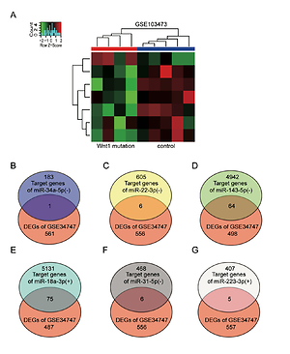

ADCY2, ADCY5, and GRIA1 as key genes of the cAMP signaling pathway in osteoporotic spinal fracture after manipulation of Wnt signaling
DOI: 10.5114/aoms/125210
Arch Med Sci 2026;22(2):1153-1163
Notes:
Introduction
Osteoporotic spinal fracture, characterized by high morbidity and mortality, has become a health burden for the aging population. Inactivation of the Wnt signaling has been proved to promote osteoporotic fractures. Our study aimed to identify key genes, miRNAs, and pathways that possibly lead to osteoporosis and osteoporotic spinal fracture after aberrant activation or mutation of the Wnt signaling pathway.
Material and methods
The impute R package was used to identify differentially expressed genes (DEGs) and differentially expressed miRNAs in GEO datasets. STRING and Metascape were used to construct a protein-protein interaction (PPI) network and perform Gene Ontology (GO) and pathway enrichment analyses. Relative expression of ADCY2, ADCY5, and GRIA1 in bone tissues was measured by RT-qPCR.
Results
562 DEGs were screened out using the impute R package, and a PPI network involving the 562 DEGs was constructed using STRING and Metascape. GO enrichment and pathway enrichment showed that the 562 DEGs were associated with membrane protein-related signaling pathways. Then, 75 genes shared between the target genes of miR-18a-3p and 562 DEGs were identified using Venny 2.1.0. Finally, the cAMP signaling pathway was identified as a key pathway, whilst ADCY2, ADCY5, and GRIA1 were identified as key genes that possibly participate in osteoporotic spinal fracture after manipulation of the Wnt signaling pathway. This was further supported by their excessive downregulation in osteoporotic patients with spinal fracture.
Conclusions
The results demonstrated that ADCY2, ADCY5, and GRIA1 are key genes regulating the cAMP signaling pathway in osteoporotic spinal fracture after abnormal Wnt signaling.

