Slide 1
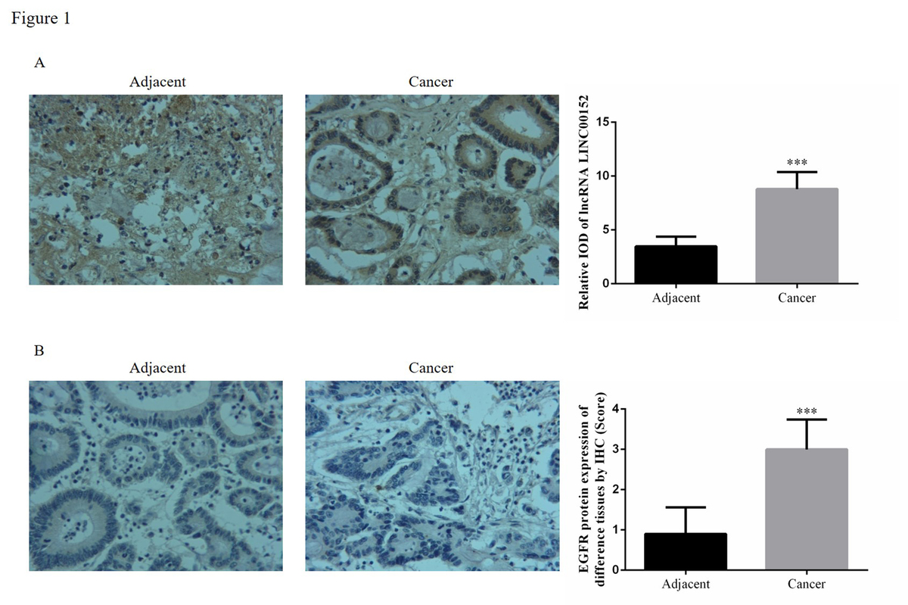

lncRNA LINC00152 knockdown suppressed hepatic cancer biological activity
DOI: 10.5114/aoms.2020.98425
Arch Med Sci 2026;22(2):1045-1063
Notes:
Introduction
Hepatic cancer is one of the most lethal cancers and has a poor prognosis. The purpose of this study was to evaluate whether lncRNA LINC 00152 had effects on the development of hepatic cancer and the related mechanisms.
Material and methods
Measuring LINC 00152 in different tissues. In in vitro experiments, we knocked down LINC 00152 expression using si-LINC00152 in HepG2 cells and evaluated cell proliferation by MTT, apoptosis by flow cytometry, invasion by Transwell, and migration by wound healing. The relative protein was evaluated by western blot. In vivo experiments included measuring tumour size and weight, using TUNEL to evaluate cell apoptosis, and measurement of relative protein expression by IHC assay.
Results
In our present study, first, we found that long non-coding RNA LINC00152 expression was significantly enhanced in hepatic cancer tissues and cell lines. Second, we revealed that LINC00152 knockdown had the effect of suppressing cell proliferation and metastasis and stimulating cell apoptosis in vitro. Third, LINC00152 down-regulation significantly suppressed tumour growth and increased cell apoptosis in an in vivo experiment. Mechanistic analyses showed that LINC00152 could regulate EGFR/PI3K/AKT/P21/MMP2/9 pathways in in vitro and in vivo experiments.
Conclusions
Our results suggest that LINC00152 contributes to the oncogenic potential of hepatic cancer and that the EGFR/PI3K/AKT/P21/MMP2/9 signalling pathway might be a potential therapeutic target for hepatic cancer.

