Slide 1
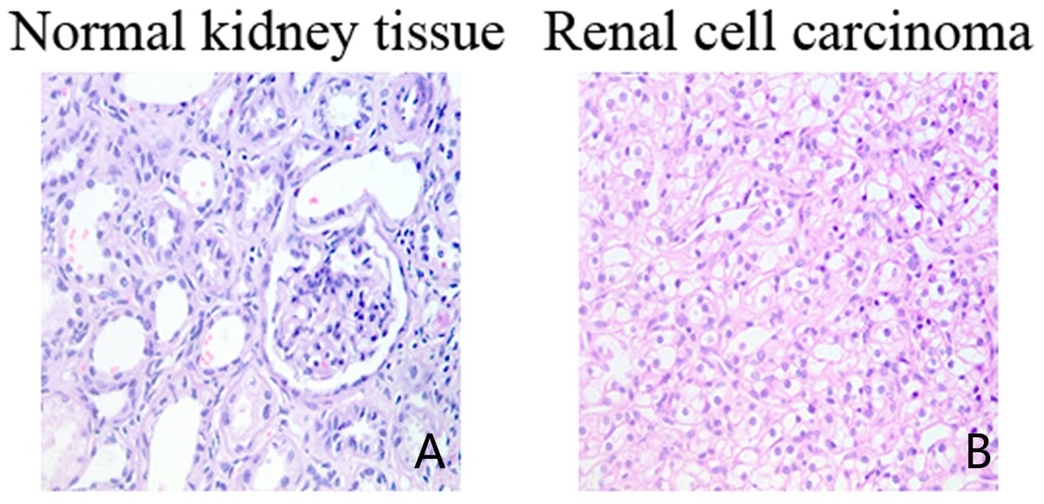

The relationship between RSUME and VHL/HIF-1α signalling pathway in renal cell carcinoma
DOI: 10.5114/aoms.2020.98040
Arch Med Sci 2026;22(2):1064-1073
Notes:
Introduction
Renal cell carcinoma (RCC) is characterised by loss of the von Hippel-Lindau tumour suppressor gene (VHL), and the functional tumourigenic consequences of this loss have been used to develop therapies for advanced renal cell carcinoma, such as targeting activation of the HIF pathway. Human RWD containing sumoylation enhancer (RSUME) has been previously reported to play a promoting role in pituitary tumours. However, the exact role of RSUME in RCC remains unclear. The present study aimed to investigate the expression levels of VHL, HIF-1α, and RSUME genes and proteins in human RCC tissues, and their correlations.
Material and methods
Immunohistochemistry and real-time PCR were applied to detect the expression levels of VHL, HIF-1α, and RSUME in normal renal tissue (control group) and RCC (experimental group).
Results
The results revealed that RSUME and HIF-1α were significantly upregulated in RCC tissues compared with normal renal tissues (p < 0.05), while the expression level of VHL was significantly lower than that in normal renal tissues (p < 0.05). Correlation analysis results showed that the expression of VHL was negatively correlated with HIF-1α and RSUME, respectively (p < 0.05). However, a positive correlation between RSUME and HIF-1α expression was observed (p < 0.05).
Conclusions
These results suggested that upregulated expression of RSUME may be involved in the formation and progression of renal cell carcinoma via interaction with VHL/HIF-1α signalling pathway, and thus RSUME may be a novel potential therapeutic target for renal cell carcinoma.

