Slide 1
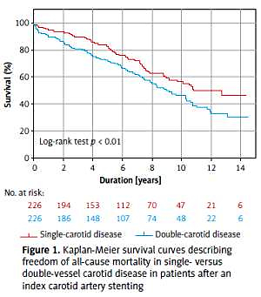

Long-term survival of carotid stenting patients with
regard to single- or double-vessel carotid artery
disease: a propensity score matching analysis
DOI: 10.5114/aoms.2020.98167
Arch Med Sci 2021;17(4):849-855
Notes:
Introduction
There is lack of long-term data outside of controlled clinical trials in carotid artery stenting (CAS). In this study, we compared the short-term outcome, long-term survival, and rate of re-interventions for restenosis in patients after CAS, related to the extent of carotid atherosclerosis classified as single-vessel (unilateral) or double-vessel (bilateral) carotid artery disease.
Material and methods
We retrospectively evaluated 599 patients with significant carotid artery stenosis, who underwent 763 CAS procedures, and used the propensity score to match 226 pairs (452 patients) in the single- or double-vessel carotid disease.
Results
There was no significant difference in the occurrence of in-hospital major adverse events (3.5% vs. 3.1% of patients in the double-vessel carotid group vs. the single-vessel carotid group; p = 1) The mean follow-up was 6.1 ±4.0 years, and a total of 181 (40%) deaths occurred during 2759 patient-years, which translates into 7.8 and 5.3 deaths per 100 patient-years in the double-vessel carotid group and the single-vessel carotid group, respectively (p < 0.01). The survival in the double-vessel carotid group vs. the single-vessel carotid group at 10 years was 46% (95% CI: 38–54%) vs. 55% (95% CI: 47–63%) (p < 0.01). Twenty-four (11%) patients and 6 (3%) patients underwent re-interventions for restenosis in the double-vessel and the single-vessel carotid disease group, respectively (p < 0.01).
Conclusions
Patients with CAS and significant double-vessel carotid artery disease had similar peri-procedural risk, but had a worse long-term survival, and a higher rate of re-interventions for restenosis compared to the single-vessel carotid artery disease patients.

