Slide 1
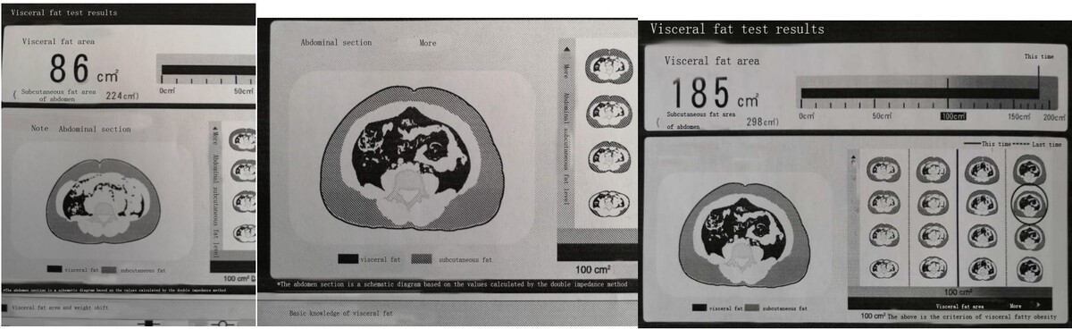

The effect of beinaglutide on visceral fat and body weight in obese type 2 diabetic patients
DOI: 10.5114/aoms.2020.98168
Arch Med Sci 2026;22(2):702-707
Notes:
Introduction
Glucagon-like peptide-1 (GLP-1) analogues could induce clinically significant weight loss in obese patients with type 2 diabetes mellitus (T2DM). Beinaglutide is a GLP-1 analogue that is fully homologous to human GLP-1. This study aims to investigate the clinical efficacy of beinaglutide in visceral fat, weight loss and blood glucose in patients with T2DM and obesity.
Material and methods
One hundred and seven obese patients with T2DM, according to the World Health Organisation’s (WHO) diagnostic criteria, were treated with beinaglutide. After 12 weeks, changes in visceral fat (VF) were analysed using DUALSCAN. Body weight, body mass index (BMI), glycated haemoglobin (HbA1c), free fatty acids, and blood pressure were also assessed after the 12-week treatment.
Results
The baselines for BMI and VF areas were 32.8 ±5.2 kg/m2 and 150.4 ±36.2 cm2, respectively. The mean HbA1c level at baseline was 8.8 ±2.3%. After 12 weeks, beinaglutide treatment showed significant decreases in VF areas (150.4 ±36.2 cm2 vs. 115.2 ±36.8 cm2, p < 0.001), body weight (90.7 ±15.8 kg vs. 84.2 ±15.6 kg, p < 0.001), HbA1c (8.8 ±2.3% vs. 7.1 ±1.7%, p < 0.001) and insulin resistance index (HOMA-IR) (5.8 ±4.3 vs. 4.2 ±2.9, p < 0.001). No changes in free fatty acids were observed. Daily doses of beinaglutide varied widely, and 74% of patients ranged from 0.24 mg to 0.30 mg each day, but the appropriate dosage significantly reduced adverse effects.
Conclusions
Beinaglutide effectively reduced VF, body weight, and blood glucose in obese patients with T2DM. Beinaglutide doses should be individualised because appropriate doses varied widely. A lack of GLP-1 might be responsible for the onset of obesity in patients with T2DM. T2DM and obesity are related not only to insulin deficiency/insulin resistance but also to GLP-1 deficiency, which may cause obesity in patients with T2DM.

