Slide 1
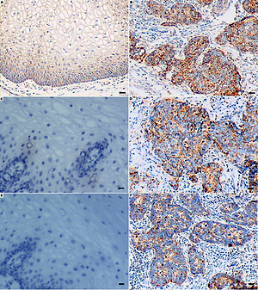

Up-regulation of peroxiredoxin 3 by high-risk human papillomavirus in cervical cancer cells
DOI: 10.5114/aoms/125932
Arch Med Sci 2026;22(3):1804-1810
Notes:
Introduction
Peroxiredoxin 3 (PRX3) is a member of the PRX family with antioxidant functions by scavenging hydrogen peroxide. Since the development of cervical cancer is causally linked to high-risk human papillomavirus (HPV) that induces oxidative stress, we conducted the present study to investigate the response of PRX3 to high-risk HPV infection.
Material and methods
This study included fifty-six patients with invasive squamous cervical cancer and sixty control patients with hysteromyoma. Enzyme-linked immunosorbent assay was performed to detect cervical oxidative stress and serum PRX3. The expression of PRX3 and oncoprotein E6 of HPV16 or HPV18 was examined in cervical cancer tissues by immunohistochemistry. Western blot was applied to detect the expression of PRX3 and E6 in cervical cancer cell lines including CaSki, HeLa, and C33A.
Results
Patients with cervical cancer showed higher serum PRX3 than control patients with hysteromyoma. Levels of oxidative markers in cervical cancer tissues were elevated as compared to normal cervical epithelia. PRX3 expression was upregulated in cervical cancer tissues and the upregulation was positively associated with the expression of E6 of HPV16 or HPV18. The association was confirmed in HPV-containing cervical cancer cell lines including CaSki and HeLa.
Conclusions
Our results indicated a positive response of PRX3 to HPV-induced oxidative stress. Serum PRX3 might be a potential indicator of active amplification of high-risk HPV in cervical cancer cells.

