Slide 1
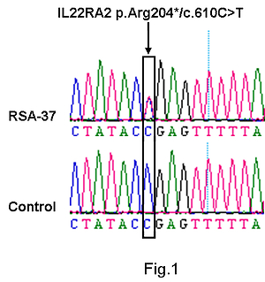

A rare variant in the <i>IL22RA2</i> gene is associated with unexplained recurrent pregnancy loss in Han Chinese women
DOI: 10.5114/aoms/126007
Arch Med Sci 2026;22(4):2205-2210
Notes:
Introduction
Recurrent pregnancy loss (RPL) occurs in ~1–2% of reproductive women. Previous studies have suggested that altered expression and polymorphisms of interleukin-related genes may be involved in RPL. The aim of this study was to explore the potential presence of interleukin-22 receptor subunit a2 (IL22RA2) mutations in Han Chinese women with unexplained recurrent pregnancy loss (URPL).
Material and methods
A total of 328 Han Chinese women with URPL were analyzed for potential mutations in the IL22RA2 gene by sequencing all of the exons. Additionally, 615 Han Chinese control women without miscarriage history were analyzed. Evolutionary conservation and in silico analyses were performed to predict the potential pathogenicity of IL22RA2 mutations.
Results
A rare variant, p.Arg204* (c.610C>T), was identified in 4 out of 328 women with URPL. In contrast, this rare variant was absent in 615 Han Chinese control women without miscarriage history and had a significantly higher mutation frequency when compared with 10,588 Chinese control women from The China Metabolic Analytics Project (ChinaMAP), 4245 East Asians, or 60051 individuals across the world from the Exome Aggregation Consortium (ExAC) database. Evolutionary conservation analysis indicated that this rare variant was highly conserved from human to zebrafish, and in silico analysis suggested that it may be pathogenic.
Conclusions
An enrichment of a potentially pathogenic rare variant in the IL22RA2 gene was observed in URPL patients for the first time, suggesting that this rare variant may be associated with the development of URPL. However, further functional assays should be performed to confirm the potential role of this rare variant in URPL.

