Slide 1
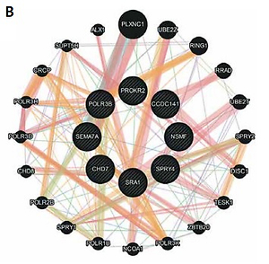

New findings in oligogenic inheritance of congenital hypogonadotropic hypogonadism
DOI: 10.5114/aoms.2020.98909
Arch Med Sci 2022;18(2):353-364
Notes:
Introduction
Congenital hypogonadotropic hypogonadism results from a dysfunction of the hypothalamic-pituitary-gonadal axis, which is essential for the development and function of the reproductive system. It may be associated with anosmia, referred to as Kallmann syndrome, or a normal sense of smell. Numerous studies have proven that hypogonadotropic hypogonadism is not simply a monogenic Mendelian disease, but that more than one gene may be involved in its pathogenesis in a single patient. The oligogenic complex architecture underlying the disease is still largely unknown.
Material and methods
Targeted next-generation sequencing (NGS) was used to screen for DNA variants in a cohort of 47 patients with congenital hypogonadotropic hypogonadism. The NGS panel consists of over 50 well-known and candidate genes, associated with hypogonadotropic state.
Results
Here we report the identification of new oligogenic variants in SPRY4/SEMA3A, SRA1/SEMA7A, CHD7/SEMA7A, CCDC141/POLR3B/POLR3B, and PROKR2/SPRY4/NSMF. These genes are known to contribute to the phenotype of hypogonadotropic hypogonadism, yet our results point to potential new “partners” underlying digenic and trigenic patterns.
Conclusions
The finding supports the importance of oligogenic inheritance and demonstrates the complexity of genetic architecture in hypogonadotropic hypogonadism. It also underlines the necessity for developing fine-tuned guidelines to provide a tool for adequate and precise sequence variant classification in non-Mendelian conditions.

