Slide 1
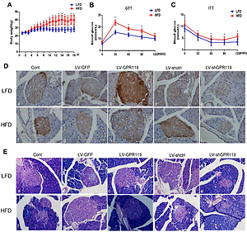

Lipotoxicity induced pancreatic beta cell damage is associated with GPR119/MST1/FoxO1 Pathway
DOI: 10.5114/aoms/126556
Notes:
Introduction
G-protein-coupled receptor 119 (GPR119) is emerging as a potential therapeutic target against type 2 diabetes with beneficial effects on glucose homeostasis. However, the function of GRP119 in lipotoxicity induced pancreatic beta cell apoptosis and the molecular mechanism remains largely unknown.
Material and methods
Impact of GPR119 on pancreatic islet beta cell apoptosis was evaluated in INS-1 cells treated with palmitate. The subsequent modulation of the MST1-FOXO1-Pdx1 signaling pathway and pro-apoptotic caspase-3 system were determined by measuring the target protein and mRNA expression. Dyslipidemia mice with gain and loss of GPR119 function by the application of specific lenti-viral vector was utilized to evaluate the impact of GPR119 on pancreas function in vivo. Lipid metabolism, glucose and insulin response, morphological changes as well as activation/inhibition of MST1-FOXO1-Pdx1 signaling pathway in pancreas were analyzed systematically.
Results
Palmitate treatment stimulated pro-apoptotic response in INS-1 cells, accompanied by inhibition of GPR119 expression and the subsequent activation of the MST1-FOXO1 combined with inhibition of Pdx1 signaling cascade. Activation of GPR119 by MBX prevents INS-1 cell from lipotoxicity induced apoptosis by targeting the MST1-FOXO1-Pdx1 pathway. Moreover, overexpression of GPR119 significantly attenuates the dyslipidemia and dysfunction of the pancreas. In contrast, inactivation of GPR119 by lentiviral vector in mice results in accelerated pancreas apoptosis and malfunction. The protective effects of GRP119 on lipotoxicity induced pancreas dysfunction are associated with modulating the MST1-FOXO1-Pdx1 signaling cascade.
Conclusions
GPR119 alleviates lipotoxicity induced pancreatic beta cell apoptosis and malfunction through regulating MST1-FOXO1-Pdx1 signaling pathway.

