Slide 1
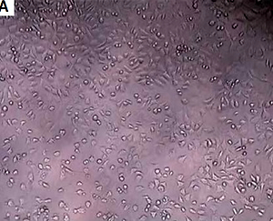

The toxicology properties of modified hydrothermal nanotitania extraction
DOI: 10.5114/aoms/127086
Arch Med Sci 2022;18(5):1338-1341
Notes:
Introduction
The nanoparticle has become a part of world industry. This substance has been proven as potentially beneficial for its usage as a cata­lyst and semi-conductor due to its high surface area and the effects of the quantum size effect. It exhibits potential characteristics and would be applied in a wider scope of usage compared to bulk particles because the smaller the size of the particles, the more room for the extent of their usage. Nano titanium dioxide application as semi-conductors together with a catalyst is highly attributed to its high photochemical stability and ability to be produced at a low-cost. The consequence of this – exposure of nano titanium dioxide particles to humans – raises concerns regarding health and safety. Therefore, this research action works designed to offer a thorough analysis of toxicology impacts produced by our own synthesis modified hydrothermal in vitro experiments.
Material and methods
Our nanotitania extraction with 0.05% silver was tested for its toxicity against L929 mouse cells. The cytotoxicity effect of nanotitania extract was evaluated by MTT assay. Cell viability (% CV) was calculated using a formula.
Results
There are non-cytotoxicity activity of 0.05% nanotitania at concentrations 1.5, 3.1, 6.3, 12.5, and 25 mg/ml on L929 cell lines except at concentration 50 and 100 mg/ml. The result was related to the optical density reading.
Conclusions
There is no cytotoxic effect of nanotitania extraction with 0.05% silver in the growth inhibition test with L929 mouse with the exception of the 100 mg/ml extract.

