Slide 1
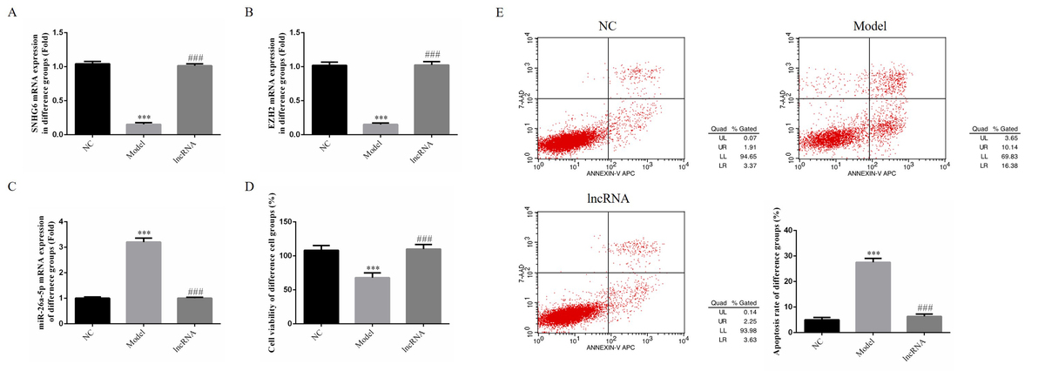

lncRNA SNHG6 improves placental villous cell function
in an in vitro model of gestational diabetes mellitus
DOI: 10.5114/aoms.2020.100643
Arch Med Sci 2026;22(4):2307-2320
Notes:
Introduction
The purpose of this research was to investigate whether lncRNA SNHG6 has an effect on the pathogenesis of gestational diabetes mellitus (GDM).
Material and methods
Placental tissue was collected from patients with GDM and from pregnant women without GDM. Expression of lncRNA SNHG6 and EZH2 in the placental tissue was detected by qRT-PCR, immunohistochemistry (IHC), and western blotting. An in vitro cell model for GDM using high-dose glucose was employed to measure relative expression of mRNA and proteins by RT-qPCR and WB assay, and cell viability, apoptosis rate, invasion cell number, and wound healing rate by CCK-8, flow cytometry, transwell assay, and wound healing assay, respectively. Correlation between miRNA-26a-5p and EZH2 was investigated with a dual-luciferase reporter assay.
Results
Compared with the control placenta, lncRNA SNHG6 and EZH2 mRNA expression levels were significantly depressed and EZH2 protein expression was significantly downregulated in GDM placenta tissues (p < 0.001, respectively). In the in vitro cell model, lncRNA SNHG6 overexpression significantly improved high-dose glucose-induced HTR-8/SVneo cell function losses, including proliferation, migration, and invasion, by significantly depressing miRNA-26a-5p via regulation of EZH2 expression. The dual-luciferase reporter assay revealed that miRNA-26a-5p could target to EZH2 in HTR-8/SVneo cells.
Conclusions
Expression of lncRNA SNHG6 in the placenta of patients with GDM is abnormally decreased. Overexpression of lncRNA SNHG6 improved HTR-8/SVneo cell function via regulation of the miRNA-26a-5p/EZH2-H3K27me3 pathway in an in vitro GDM model.

