Slide 1
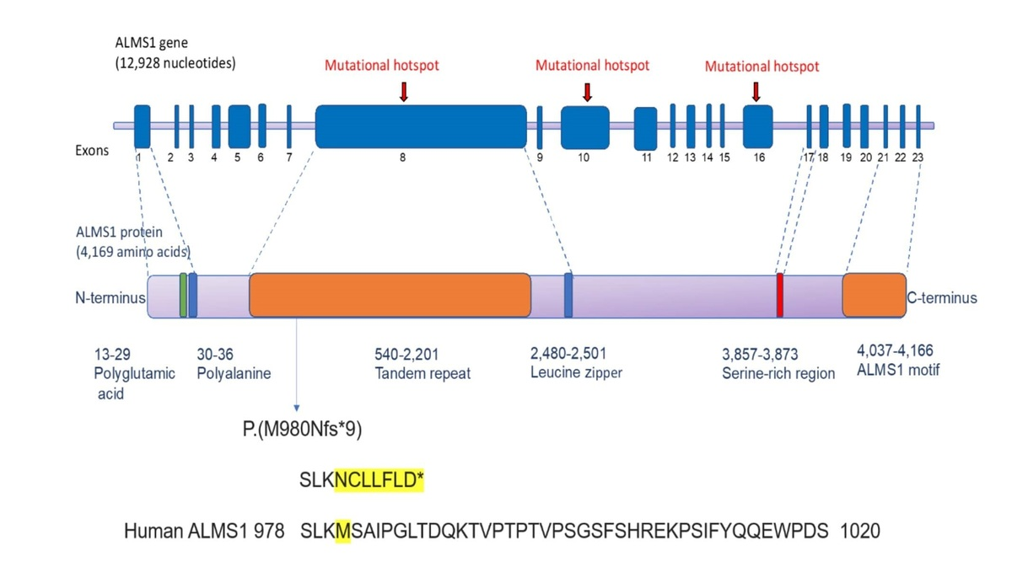

A novel homozygous ALMS1 protein truncation mutation (c.2938dupA) revealed variable clinical expression among Saudi Alström syndrome patients
DOI: 10.5114/aoms.2020.100635
Arch Med Sci 2026;22(4):2197-2204
Notes:
Introduction
Alström syndrome, ALMS (OMIM 203800) is a rare multi-systemic disease. The characteristic clinical features include blindness due to progressive cone-rod dystrophy, sensorineural hearing loss, type 2 diabetes mellitus, dilated cardiomyopathy, and childhood obesity. The aim of this study was to identify the genetic cause of Alström syndrome in patients who presented with variable clinical characteristics.
Material and methods
Clinical phenotyping and whole exome sequencing were performed in Saudi Alström syndrome patients. The Sanger sequencing was done to ascertain the segregation of Alström syndrome causative mutation in the family members. The rare prevalence of this mutation was further established by sequencing an additional 100 healthy Saudi controls.
Results
Whole exome sequencing analysis revealed that Alström syndrome patients have inherited a novel homozygous protein truncating mutation (c.2938dupA) in the ALMS1 gene segregated in an autosomal recessive fashion. This variant was absent in healthy controls. Genotype-phenotype analysis showed its interesting association with intra-familial clinical variability with regards to vision abnormalities, age at onset of dilated cardiomyopathy (DCM), obesity and hearing loss symptoms in the Alström syndrome patients.
Conclusions
Our findings indicate that the atypical presentation of Alström syndrome, even within siblings, could sometimes lead to clinical misdiagnosis. Hence, the present study emphasizes the utility of exome sequencing to support the clinical diagnosis of Alström syndrome patients.

