Slide 1
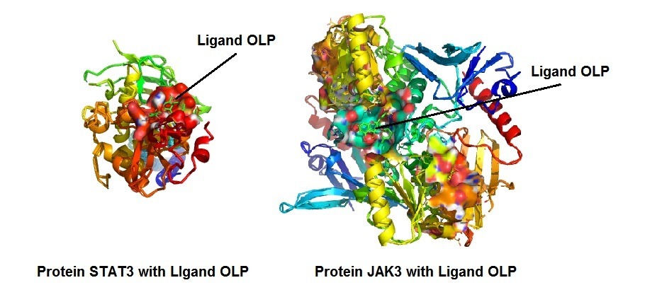

Oleuropein modulates over-proliferation of keratinocytes in mice with imiquimod-mediated psoriasis and inhibits differentiation of Th17 cells through the JAK3/STAT3 axis
DOI: 10.5114/aoms.2020.100642
Arch Med Sci 2026;22(4):2445-2456
Notes:
Introduction
Oleuropein (OLP) is polyphenol obtained from olive oil; it is proved in Chinese traditional medicine for its use in disorders including autoimmune and inflammatory disorders. Psoriasis (PSR) is an autoimmune and inflammatory disorder triggered by T-helper-17 (Th17) cells.
Material and methods
We developed an imiquimod (IMQ)-mediated PSR model in mice to study the anti-inflammatory role of OLP in psoriasis. The mice were given 50 mg/kg and 100 mg/kg dose of OLP. Histology was done to assess the inflammation of lesions. Western blot analysis was done for JAK3/STAT3 in isolated T cells, expression of RORt was done by RT-PCR. The In silico molecular docking studies were done for interaction of OLP with target protein STAT3 and JAK3.
Results
Treatment of OLP attenuated proliferation in IMQ-mediated keratinocytes, improved infiltration of CD3+ cells in the skin lesions and in CD4+ and CD8+ T cells and also ameliorated the levels of cytokines. In in vitro studies in isolated T cells, OLP blocked the differentiation of Th17 cells and also the levels of IL-17 and the JAK3/STAT3 pathway. The in silico docking showed that OLP had potential binding affinity with JAK3 and STAT3 which was parallel to in vivo and in vitro findings.
Conclusions
OLP ameliorates psoriasis skin lesions by blocking Th17-mediated inflammation. OLP may be an interesting molecule for treating autoimmunity in psoriasis.

