Slide 1
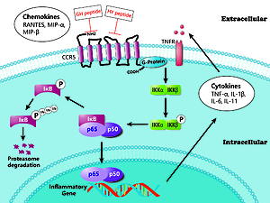

Inhibition of inflammatory cell infiltration by antagonistic peptides that specifically bind to CCR5 via regulation of the NF-kB signaling pathway in rats with colitis
DOI: 10.5114/aoms/127587
Arch Med Sci 2024;20(6):2022-2033
Notes:
Introduction
CC chemokine receptor 5 (CCR5) and the NF-kB signaling pathway play important roles in the pathophysiology of inflammatory bowel disease (IBD). Previously, we synthesized two peptides (GH and HY peptides) that specifically bind to the first and the second extracellular loops (ECL1 and ECL2, respectively) of CCR5 and preliminarily found an inhibitory effect of these peptides on colitis. However, the specific mechanism by which these two peptides regulate trinitrobenzene sulfonic acid (TNBS)-induced colitis in rats remains unclear. Aim of the study was to further investigate the effect and mechanism of CCR5 binding peptides in rat colitis.
Material and methods
Experimental colitis was induced by 5% TNBS. CCR5 antagonist peptides were administered intravenously once a day for a week. Histological evaluation, real-time PCR, western blotting and correlation analysis were performed to examine the effects of the CCR5 binding peptides on the infiltration of inflammatory cells and the NF-kB signaling pathway.
Results
Administration of GH and HY peptides ameliorated mucosal damage and reduced the infiltration of neutrophils, lymphocytes and macrophages in experimental colitis (p < 0.05). The expression of NF-kB-related genes, including p105, p100, IKK and TNF-α, was reduced after GH and HY peptide administration (p < 0.01), and the protein level of TNF-α and the phosphorylation of IKK, IkBα and p65 were also suppressed. Furthermore, the CCR5 antagonist peptides inhibited nuclear translocation of p65. Spearman correlation analysis showed that the infiltration of inflammatory cells was significantly correlated with the NF-kB pathway.
Conclusions
Antagonistic peptides that specifically bind to ECL1 and ECL2 of CCR5 inhibit the infiltration of neutrophils, lymphocytes and macrophages in the colonic mucosa of SD rats with TNBS-induced colitis via regulation of the NF-κB signaling pathway.

