Slide 1
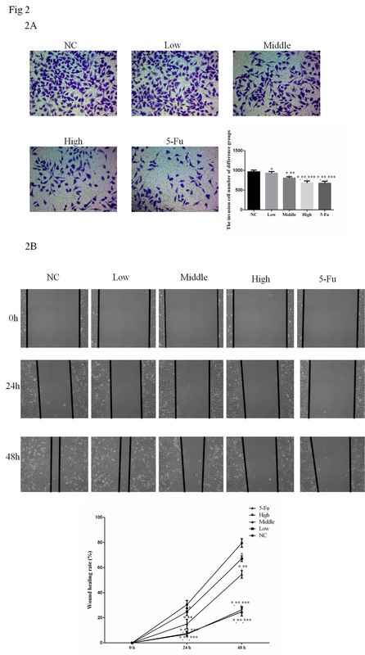

Ellagic acid inhibited cervical cancer growth via blocking the AKT/mTOR/STAT3 pathway
DOI: 10.5114/aoms.2020.100837
Arch Med Sci 2026;22(4):2389-2403
Notes:
Introduction
Ellagic acid (EA) is a kind of herb extract. However, the effects and mechanisms of EA in cervical cancer treatment are unclear.
Material and methods
Our present work investigated the effects of EA on HeLa cervical cancer cell biological activities and relative mechanisms. Hela cells were divided into 5 groups as the NC group, Low group, Middle group, High group and 5-Fu group. MTT assay and cell apoptosis assay were performed to evaluate cell proliferation and apoptosis. Wound closure assay was used to assess the effect of EA on HeLa cell migration. We also assessed the anti-tumor effect of EA on a cervical tumor bearing BALB/c mouse model. Furthermore, western blotting and immunohistochemistry assay were performed to evaluate the effect of EA on the activation of AKT/mTOR/STAT3 in vitro and in vivo.
Results
The cell experiments showed that EA had effects to inhibit Hela cell biological activities including cell apoptosis, migration and invasion dose-dependently and AKT, mTOR, and STAT3 phosphorylation expression levels were significantly depressed after EA supplementation in the in vitro study. In the in vivo study, EA significantly depressed tumor growth with cell apoptosis significantly increasing and the AKT/mTOR/STAT3 pathway was significantly down-regulated in tumor tissues.
Conclusions
EA had anti-tumor effects on cervical cancer by depressing the AKT/mTOR/STAT3 pathway in in vitro and in vivo study.

