Slide 1
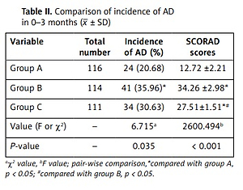

Clinical study on prevention of atopic dermatitis by oral administration of probiotics in infants
DOI: 10.5114/aoms.2020.100639
Arch Med Sci 2023;19(1):101-106
Notes:
Introduction
This study aimed to investigate the preventive effects of oral administration of probiotics on the incidence and severity of atopic dermatitis (AD) in infants.
Material and methods
A total of 396 full-term infants were enrolled in this study. Of these, 132 newborns without a family history of AD were assigned to group A, and the other 264 newborns were randomly divided into groups B and C. Infants in groups A and B were solely breastfed, while probiotics were administered to those in group C as well as breastfeeding. The information of all subjects was recorded, and the incidence of AD was followed up. The levels of serum IgE and IL-4 were measured at the age of 3 years.
Results
The incidence of AD in infants in group B was higher than that in group A at 3 months, 4–6 months, and 7–36 months after birth, together with increased symptom scores. For infants in group C, the incidence of AD at 4–6 months and 7–36 months after birth and the SCORAD scores at 0–3 months and 4–6 months after birth were lower than those in group B. The levels of IgE and IL-4 in group B were higher than those in groups A and C at 36 months old.
Conclusions
Adding probiotics could favor the establishment of the intestinal microecological balance in the neonatal period, thereby reducing the incidence of AD, decreasing the levels of serum immune indexes and alleviating the severity of the disease.

