Slide 1
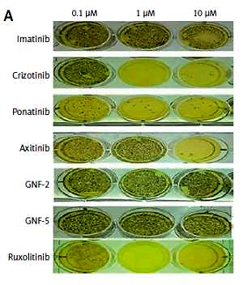

Mesenchymal soluble factors confer imatinib drug resistance in chronic myelogenous leukemia cells
DOI: 10.5114/aoms.2020.101042
Arch Med Sci 2021;17(1):266-274

