Slide 1
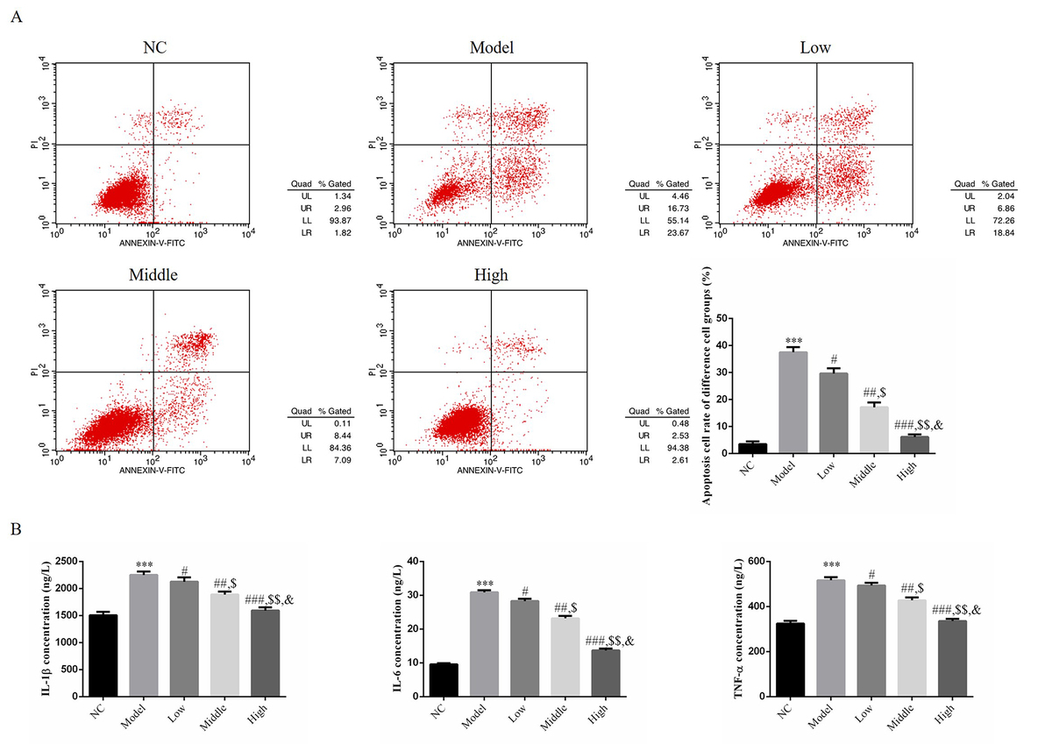

Vitamin D ameliorated endothelial cell damage induced by diabetes via regulation of lncRNA MEG3 in human umbilical vein endothelial cells
DOI: 10.5114/aoms.2020.101248
Arch Med Sci 2026;22(4):2321-2333
Notes:
Introduction
The purpose of this study was to investigate long non-coding RNA (lncRNA) maternally expressed gene 3 (MEG3) effects in vitamin D (Vit. D) treatment in endothelial cell damage induced by diabetes.
Material and methods
We used human umbilical vein endothelial cells (HUVECs) as a research objective in our study and used high glucose in a diabetic cell model. We evaluated cell apoptosis by flow cytometry, inflammatory factors (IL-6, IL-1β and TNF-α) concentrations by ELISA assay, relative gene and protein expression by RT-qPCR and WB assay, and NF-κB(p65) nuclear volume by cellular immunofluorescence.
Results
Compared with the NC (normal control) group, the cell apoptosis rate was significantly increased, inflammatory factor (IL-6, IL-1β and TNF-α) concentrations were significantly up-regulated, lncRNA MEG3 gene expression was significantly depressed, Toll-like receptor 4 (TLR4), myeloid differentiation factor 88 (MyD88) and nuclear factor κB p65 (NF-κB(p65)) gene and protein expression levels were significantly increased and NF-κB(p65) nuclear volume was significantly up-regulated (p < 0.001, respectively). With Vit. D supplementation, compared with the Model group, Vit. D improved endothelial cell damage induced by diabetes, while lncRNA MEG3 was significantly increased and the TLR4/MyD88/NF-κB(p65) pathway was significantly depressed dose-dependently (all p < 0.05). With sh-MEG3 transfection, the Vit. D treatment effects were significantly reduced.
Conclusions
Vit. D improved endothelial cell damage induced by diabetes via lncRNA MEG3 up-regulation in vitro study.

