Slide 1
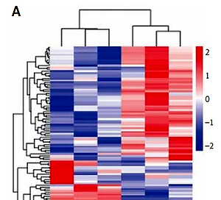

Circulating exosomal lncRNAs in patients with chronic coronary syndromes
DOI: 10.5114/aoms/128014
Arch Med Sci 2023;19(1):46-56
Notes:
Introduction
The concept of chronic coronary syndrome (CCS) was first presented at the European Society of Cardiology Meeting in 2019. However, the roles of exosomal lncRNAs in CCS remain largely unclear.
Material and methods
A case-control study was performed with a total of 218 participants (137 males and 81 females), including 15 CCS patients and 15 controls for sequencing profiles, 20 CCS patients and 20 controls for the first validation, and 100 CCS patients and 48 controls for the second validation. Exosomes were isolated from the plasma of CCS patients and controls, and exosomal lncRNAs were identified by sequencing profiles and verified twice by qRT-PCR analysis. Receiver operating characteristic (ROC) curve analysis was performed to evaluate the diagnostic value of exosomal lncRNAs for CCS patients.
Results
A total of 152 significantly differentially expressed lncRNAs with over two-fold changes were detected in plasma exosomes of CCS patients, including 90 upregulated and 62 downregulated lncRNAs. Importantly, 6 upregulated lncRNAs with the top fold changes were selected for validations. Exosomal lncRNAs ENST00000424615.2 and ENST00000560769.1 were significantly elevated in CCS patients in both validations compared with controls. The areas under the ROC of lncRNAs ENST00000424615.2 and ENST00000560769.1 were 0.654 and 0.722, respectively. Additionally, exosomal lncRNA ENST00000560769.1 was significantly higher in the CCS patients with more diseased vessels (p = 0.028).
Conclusions
Exosomal lncRNA ENST00000424615.2 and ENST00000560769.1 were identified as novel diagnosis biomarkers for patients with CCS. Moreover, exosomal lncRNA ENST00000560769.1 was significantly higher in the CCS patients with more diseased vessels, and might be associated with a poor prognosis.

