Slide 1
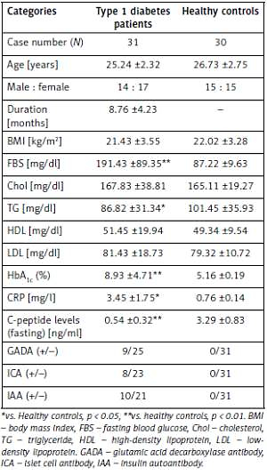

Decreased interleukin-35 levels and CD4+EBI3+ T cells in patients with type 1 diabetes and the effects of the antibody against CD20 (rituximab)
DOI: 10.5114/aoms.2020.101510
Arch Med Sci 2021;17(1):258-261

