Slide 1
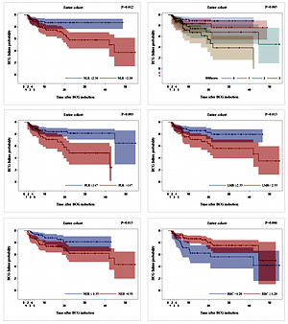

Blood count-derived inflammatory markers predict time to Bacillus Calmette-Guérin failure in high-risk non-muscle-invasive bladder cancer
DOI: 10.5114/aoms/130303
Arch Med Sci 2026;22(4):2175-2183
Notes:
Introduction
Bacillus Calmette-Guérin (BCG) treatment failure remains a significant clinical problem in patients with high-risk non-muscle-invasive bladder cancer (NMIBC). The European Organization for Research and Treatment of Cancer (EORTC) and Spanish Urological Club for Oncological Treatment (CUETO) risk scores remain the most commonly used models in the prediction of NMIBC recurrence and progression. On the other hand, well-established predictors of BCG failure are still lacking. Our aim was to evaluate the utility of blood count-derived inflammatory markers for BCG failure prediction in patients with high-risk NMIBC.
Material and methods
One hundred and eighty-three consecutive patients with high-risk NMIBC, who underwent transurethral resection of the bladder tumour (TURBT) and were further treated with BCG instillations were included in the study. Bacillus Calmette-Guérin failure was retrospectively determined based on European Association of Urology 2019 guidelines. Differences in BCG failure-free survival were assessed using the log-rank test. Logistic regression was utilized for uni- and multivariate analysis.
Results
Kaplan-Meier analysis revealed that patients with a high preoperative neutrophil-to-lymphocyte ratio (NLR > 2.3), platelet-to-lymphocyte ratio (PLR > 147), neutrophil-to-erythrocyte ratio (NER > 0.93), higher systemic inflammatory marker (SIM) score and with a low lymphocyte-to-monocyte ratio (LMR < 2.55) had shorter time to BCG failure (p < 0.05). In the multivariate model, all markers except for LMR remained a significant adjunct to the CUETO recurrence risk score when predicting BCG failure.
Conclusions
Our study demonstrates the utility of blood count-derived inflammatory markers in the prediction of BCG failure in high-risk NMIBC. Implementation of NLR, PLR, NER and SIM score might be of clinical value especially when combined with the CUETO scoring system.

